Slide 1
Learning Objectives
Name the cell types of the Islets of Langerhans and name the hormones secreted by them.
Describe the main targets and functions of glucagon.
List the major factors that stimulate or inhibit glucagon and insulin.
Describe the important physiological roles of insulin.
List the major actions of insulin in muscle, adipose tissue, and liver.
Explain briefly the mechanism of glucose uptake into the muscle.
Name the tissues in which insulin facilitates glucose uptake and those in which insulin does not facilitate glucose uptake.
List the major factors that stimulate or inhibit insulin secretion.
Draw an oral glucose tolerance test (oGTT) (glucose, insulin, and glucagon levels) and and describe what is occurring and why. Explain how the two hormones act to promote glucose homeostasis in the plasma.
State which nutrient storages are preferably used for short-term regulation of energy metabolism if no nutrients are available from the GI tract.
Discuss the hormones involved, fuel storage capacity, fuel storage consumption, and glucose (or fatty acid) levels during 1) the postprandial period, 2) the post-absorptive period, 3) fasting.
List the insulin-counteracting hormones and their roles in glucose homeostasis. Discuss the hormones involved in minute-to-minute regulation and long-term regulation of glucose homeostasis.

Slide 2
Oral glucose tolerance test
Draw what happens to glucose after a meal over time
Sketch out changes in glucagon, insulin and GLP-1
Sketch out a new one, for someone who is a type I diabetic (show insulin and GLP-1)
Sketch out a new one, for someone who is a type II diabetic (show insulin, glucagon and GLP-1)

Slide 3
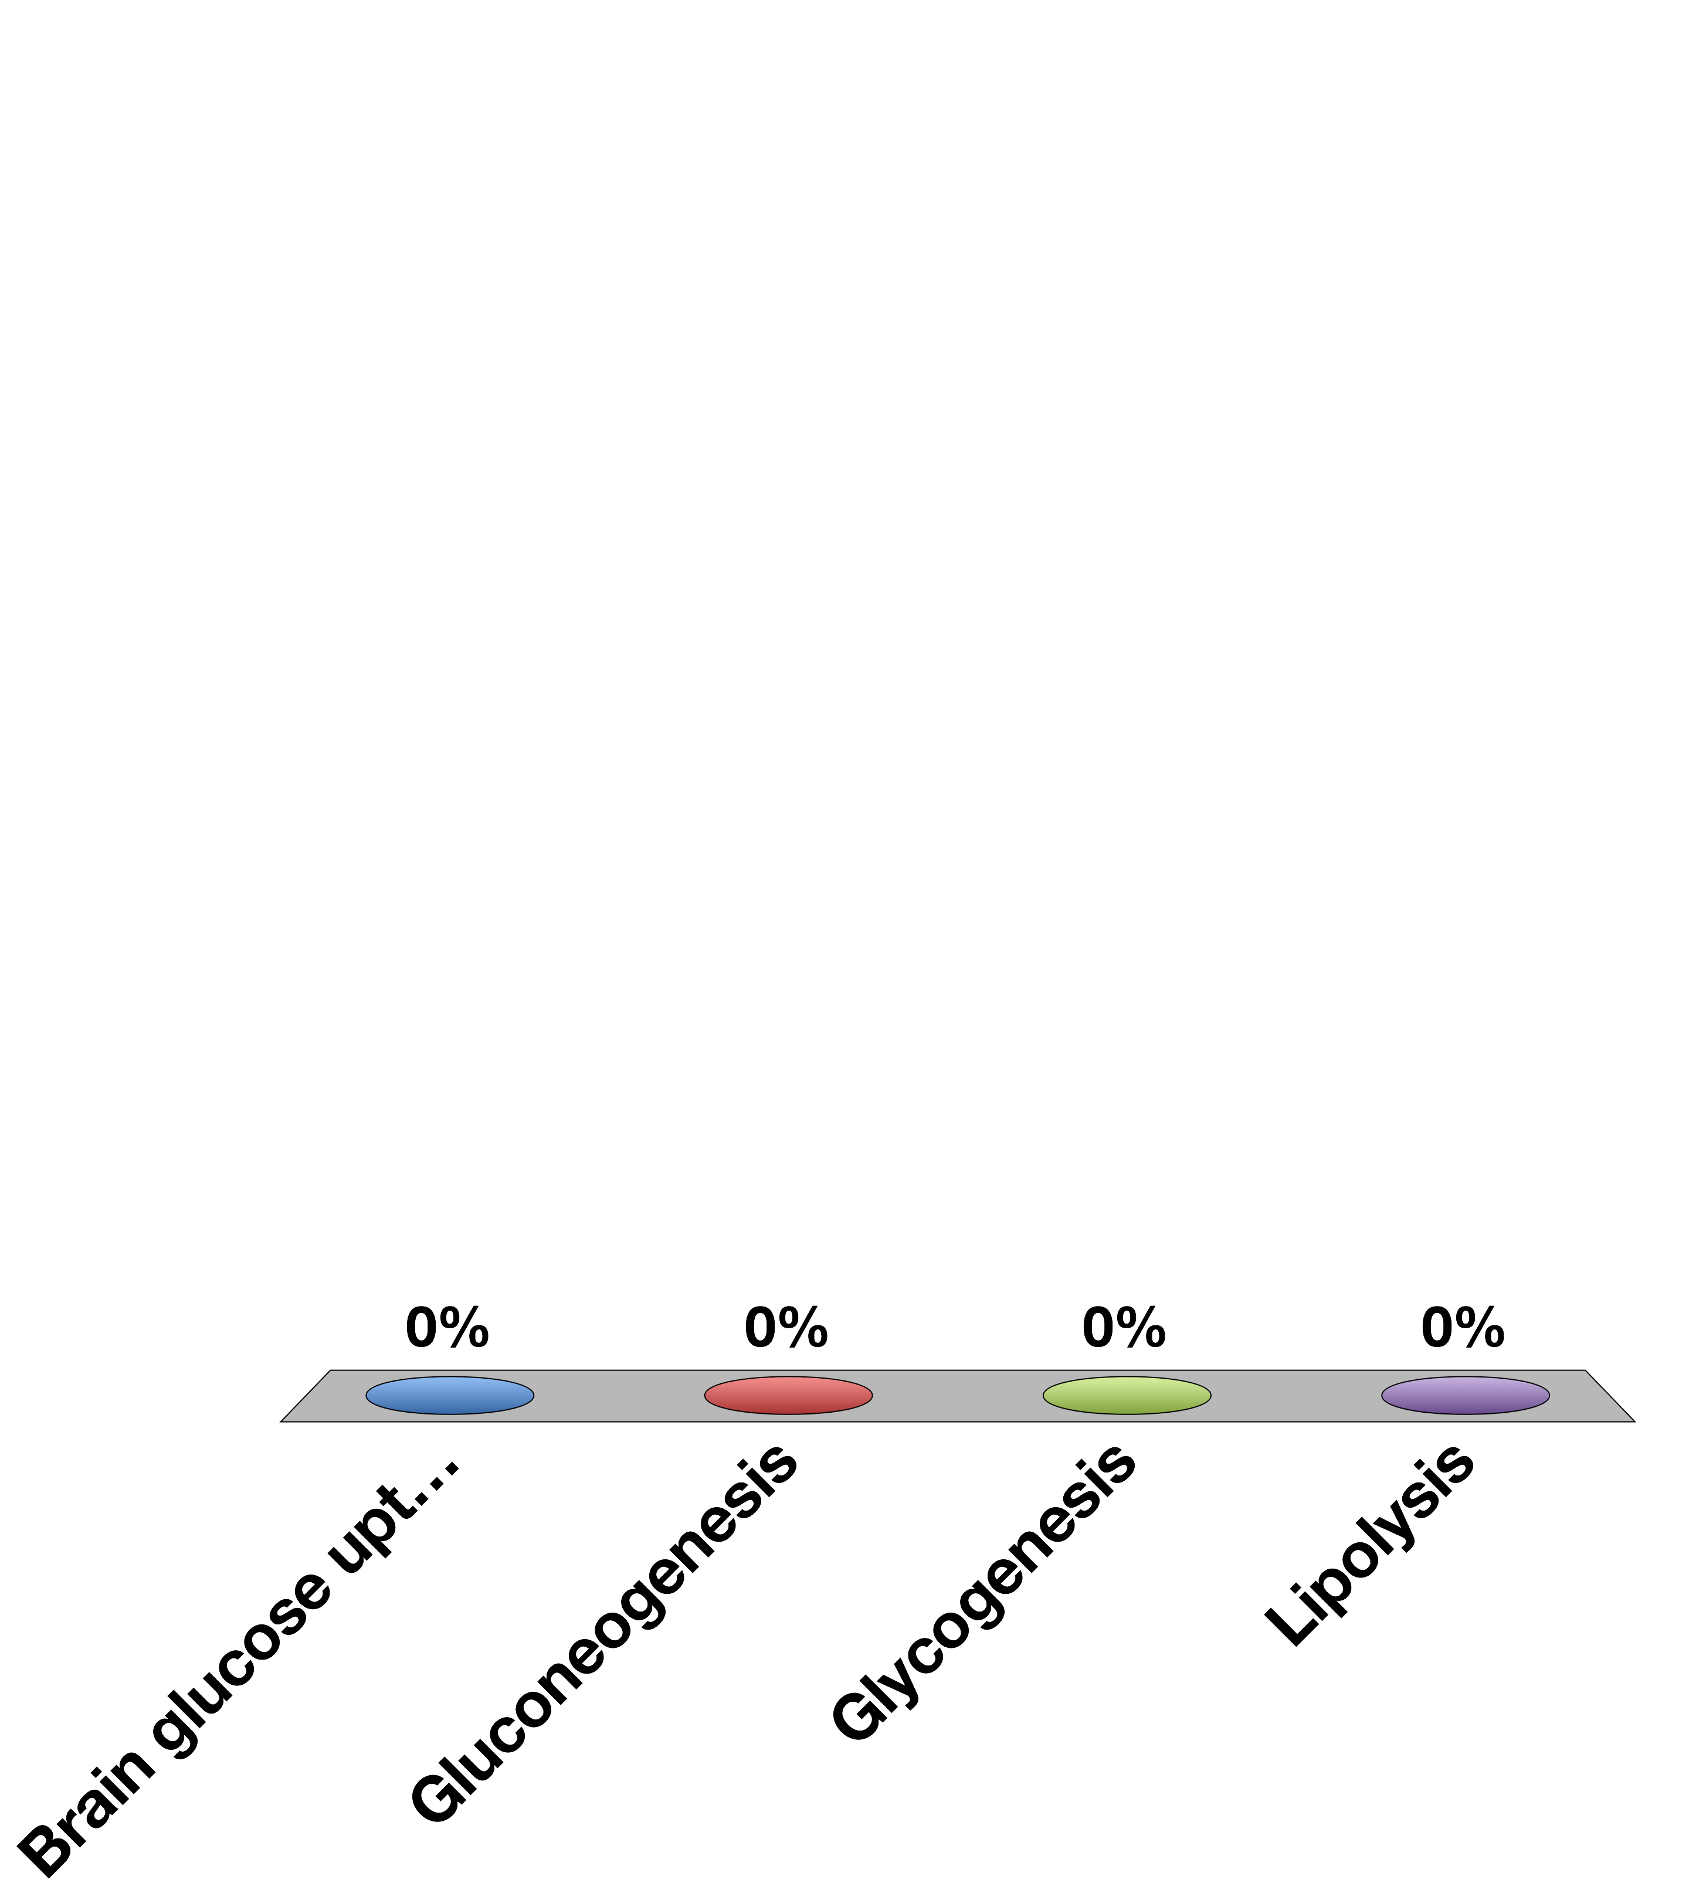
Which Process Does Insulin Activate?
Brain glucose uptake
Gluconeogenesis
Glycogenesis
Lipolysis
15

Slide 4
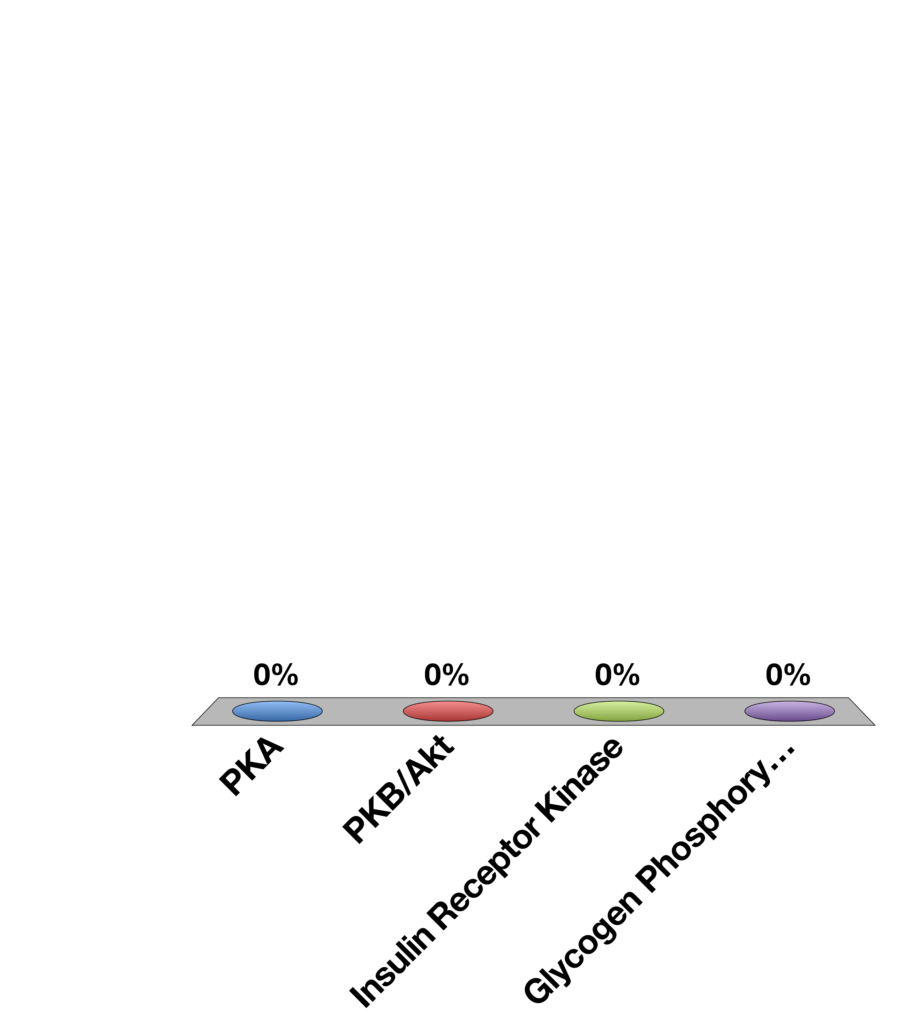
What Protein Kinase is the Primary Mediator of Glucagon Action
PKA
PKB/Akt
Insulin Receptor Kinase
Glycogen Phosphorylase
15

Slide 5
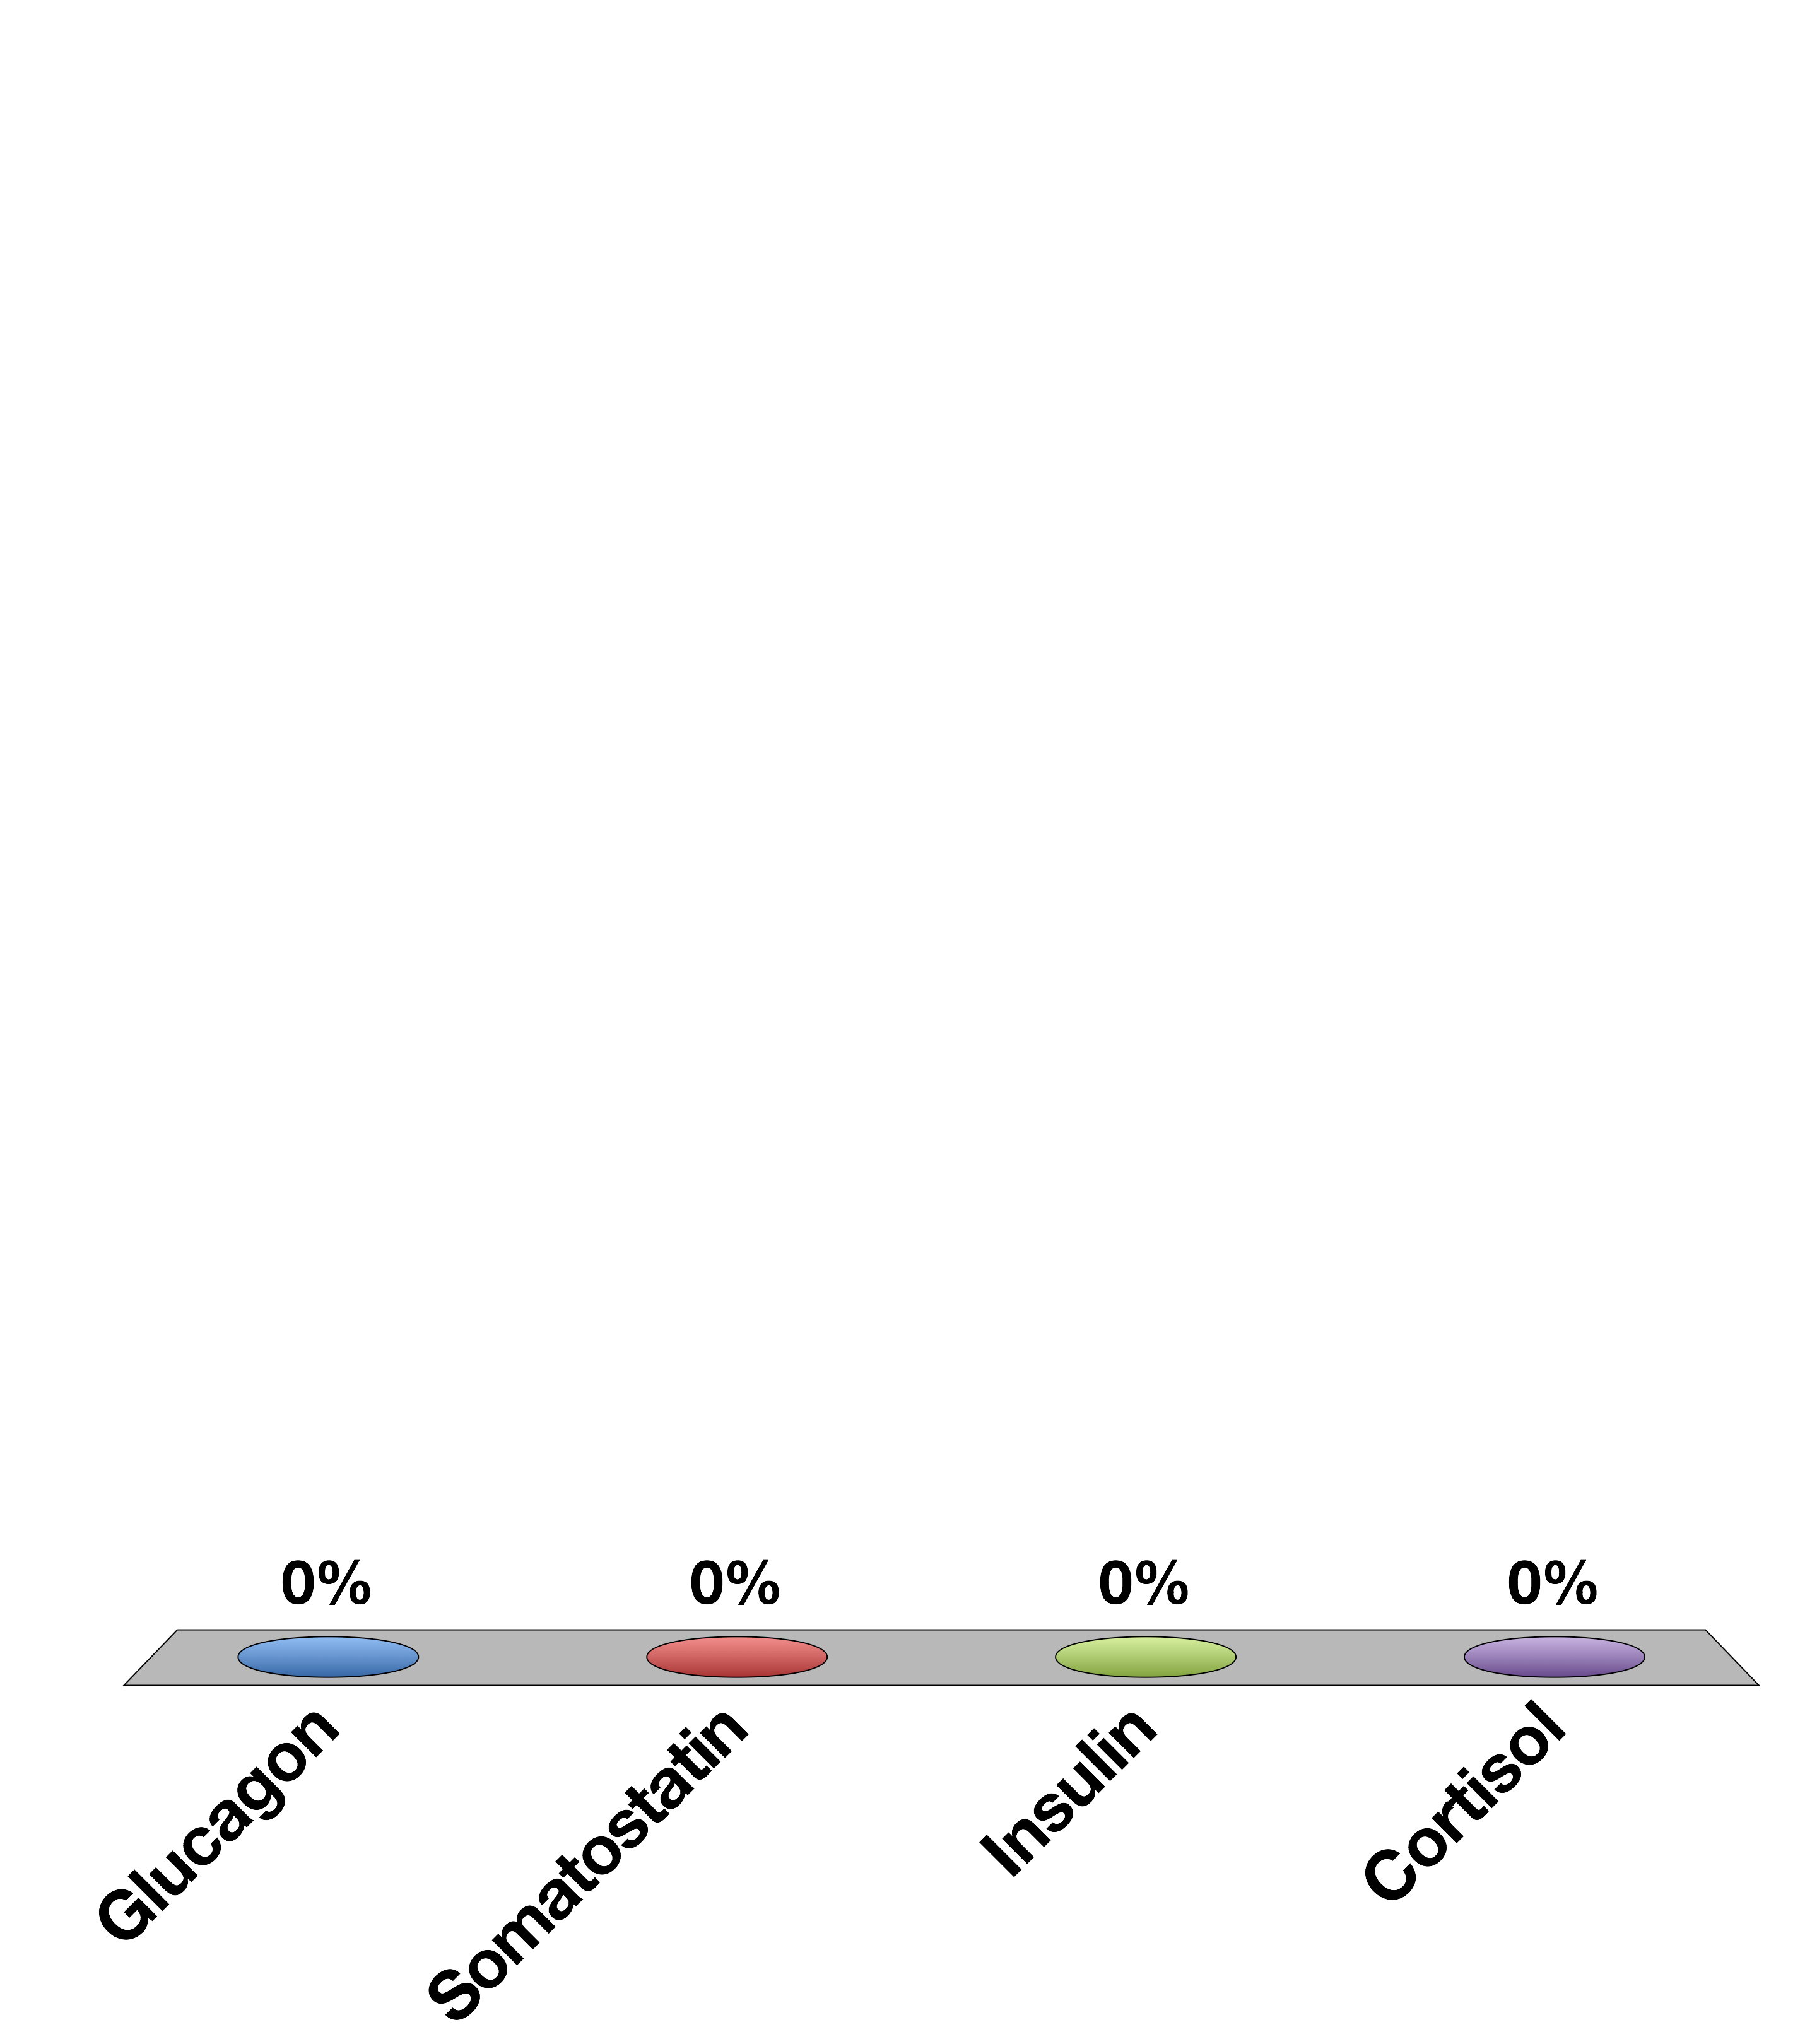
Which Hormone is Released from Pancreatic Delta Cells
Glucagon
Somatostatin
Insulin
Cortisol
15

Slide 6
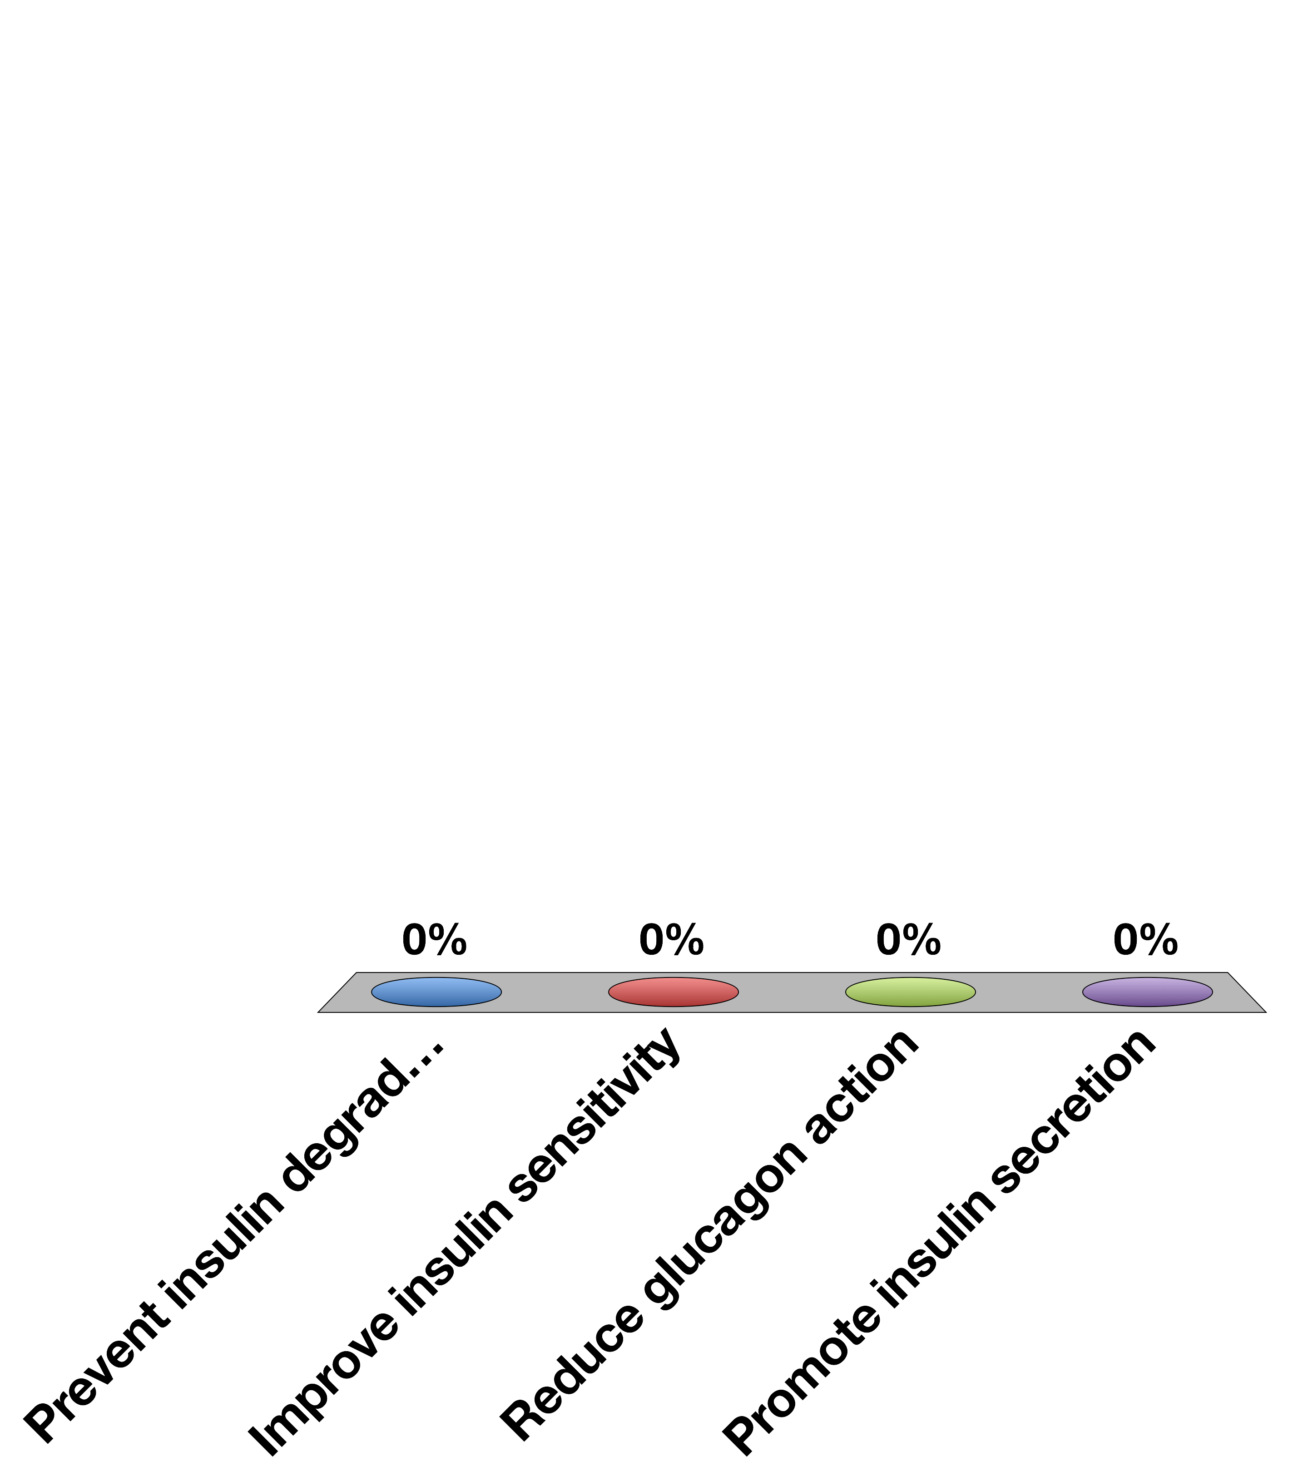
How Would A DPP-4 Inhibitor Help Glucose Control?
Prevent insulin degradation
Improve insulin sensitivity
Reduce glucagon action
Promote insulin secretion
15

Slide 7
Adrenal Gland and Stress Hormones

Slide 8
Learning Objectives
Name three zones in the adrenal cortex and major regulator(s) of each zone.
Name three steroidogenesis pathways and their major products.
Describe the physiological actions and roles of aldosterone.
Explain briefly the renin-angiotensin system.
Describe the negative feedback regulation of aldosterone and its relationship to blood volume/blood pressure homeostasis.
Describe hepatic and extrahepatic metabolic actions of glucocorticoids. Discuss their relationship.
Name the major hormones secreted from the adrenal medulla. Discuss the differences of epinephrine (epi) and norepinephrine (NE) in cardiovascular actions (physiological levels).
List the major metabolic actions of catecholamines.
Contrast the thresholds for actions vs. plasma levels of epi and NE under common conditions, like exercise, and in the disease pheochromocytoma

Slide 9
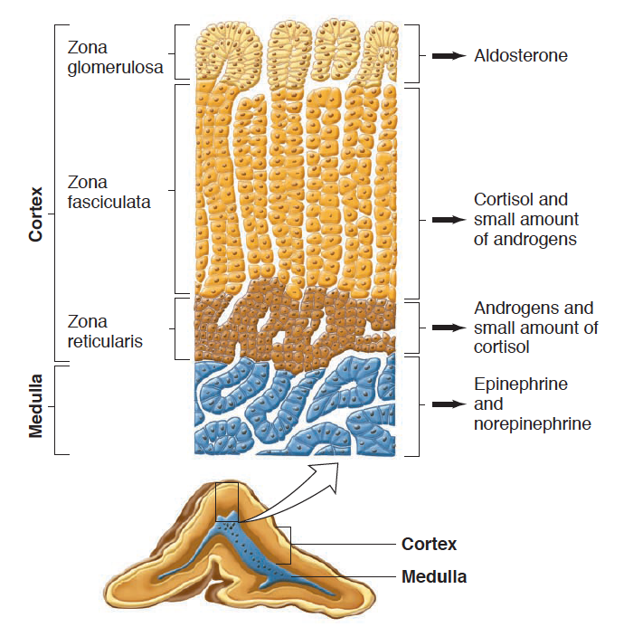
Adrenal Gland Anatomy
Notes:
Recall back to the anterior pituitary that there are specialized cell types that are hormone factories.
We are going to talk about the steroid hormones first, then the biogenic amines

Slide 10
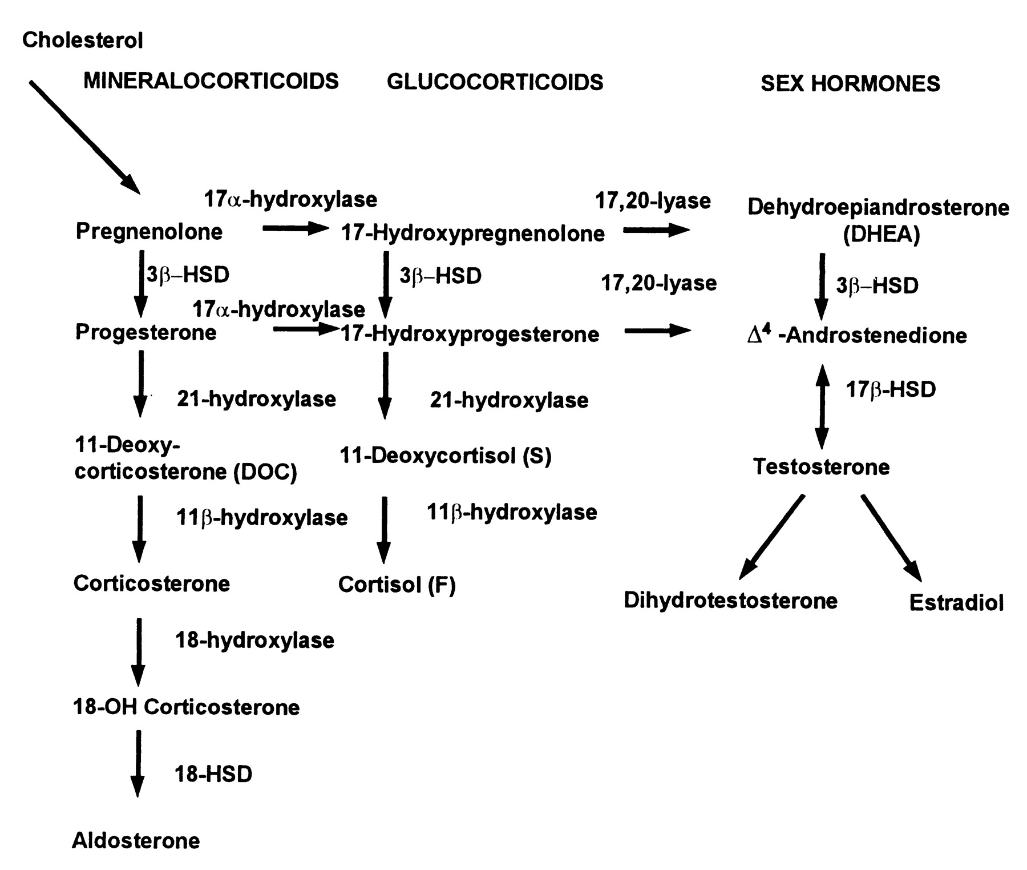
Steroid Hormone Biosynthesis
Maria I. New, and Robert C. Wilson PNAS 1999;96:12790-12797
Notes:
Don’t need to know these enzymes, but you do need to know there are three major pathways

Slide 11
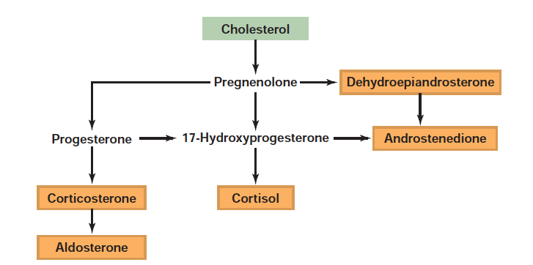
Steroid Hormone Synthesis

Slide 12
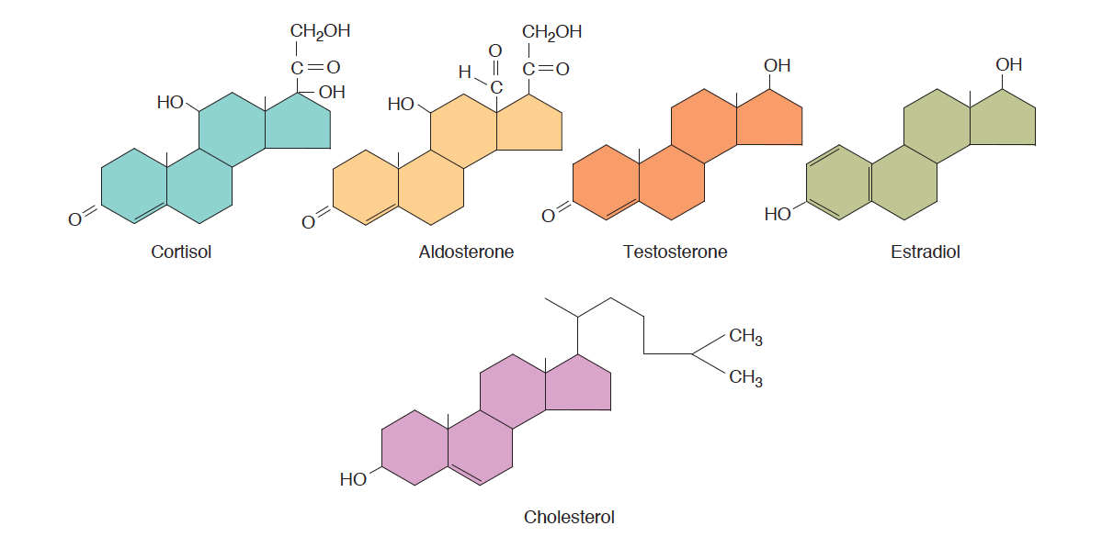
Steroid Hormones Released From Adrenal Medulla
Notes:
Note that cortisol and aldosterone have fairly similar structures

Slide 13
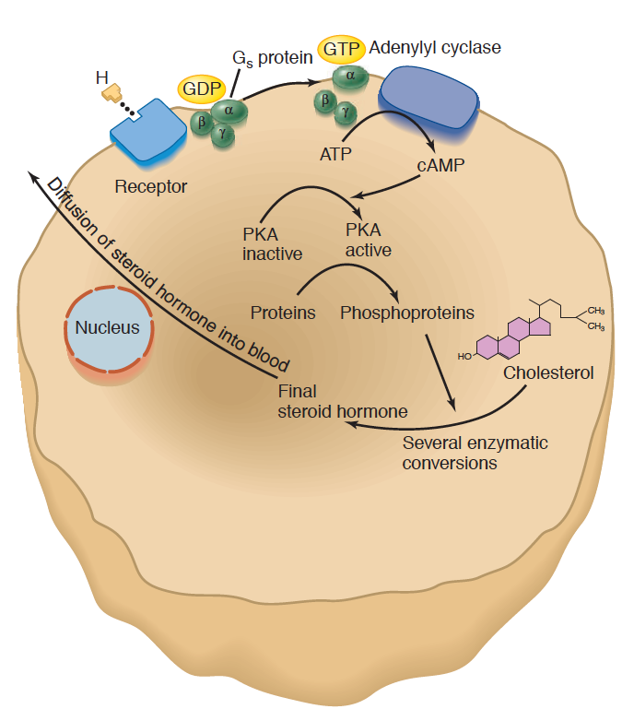
Adrenal Steroid Hormone Synthesis Mechanisms
Signal | Receptor | Hormone
ACTH | MC2R (GPCR - Gs) | Cortisol
Angiotensin II | AGTR1 (GPCR – Gq) | Aldosterone
Notes:
Regulated by increasing the synthesis of the relevant steroids, which are then passively released into the blood

Slide 14
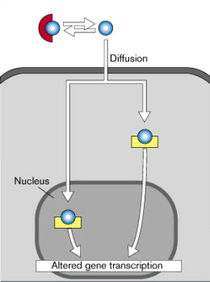
Both Aldosterone and Cortisol Function Through Nuclear Hormone Signaling

Slide 15
Aldosterone Regulates Mineral Balance

Slide 16
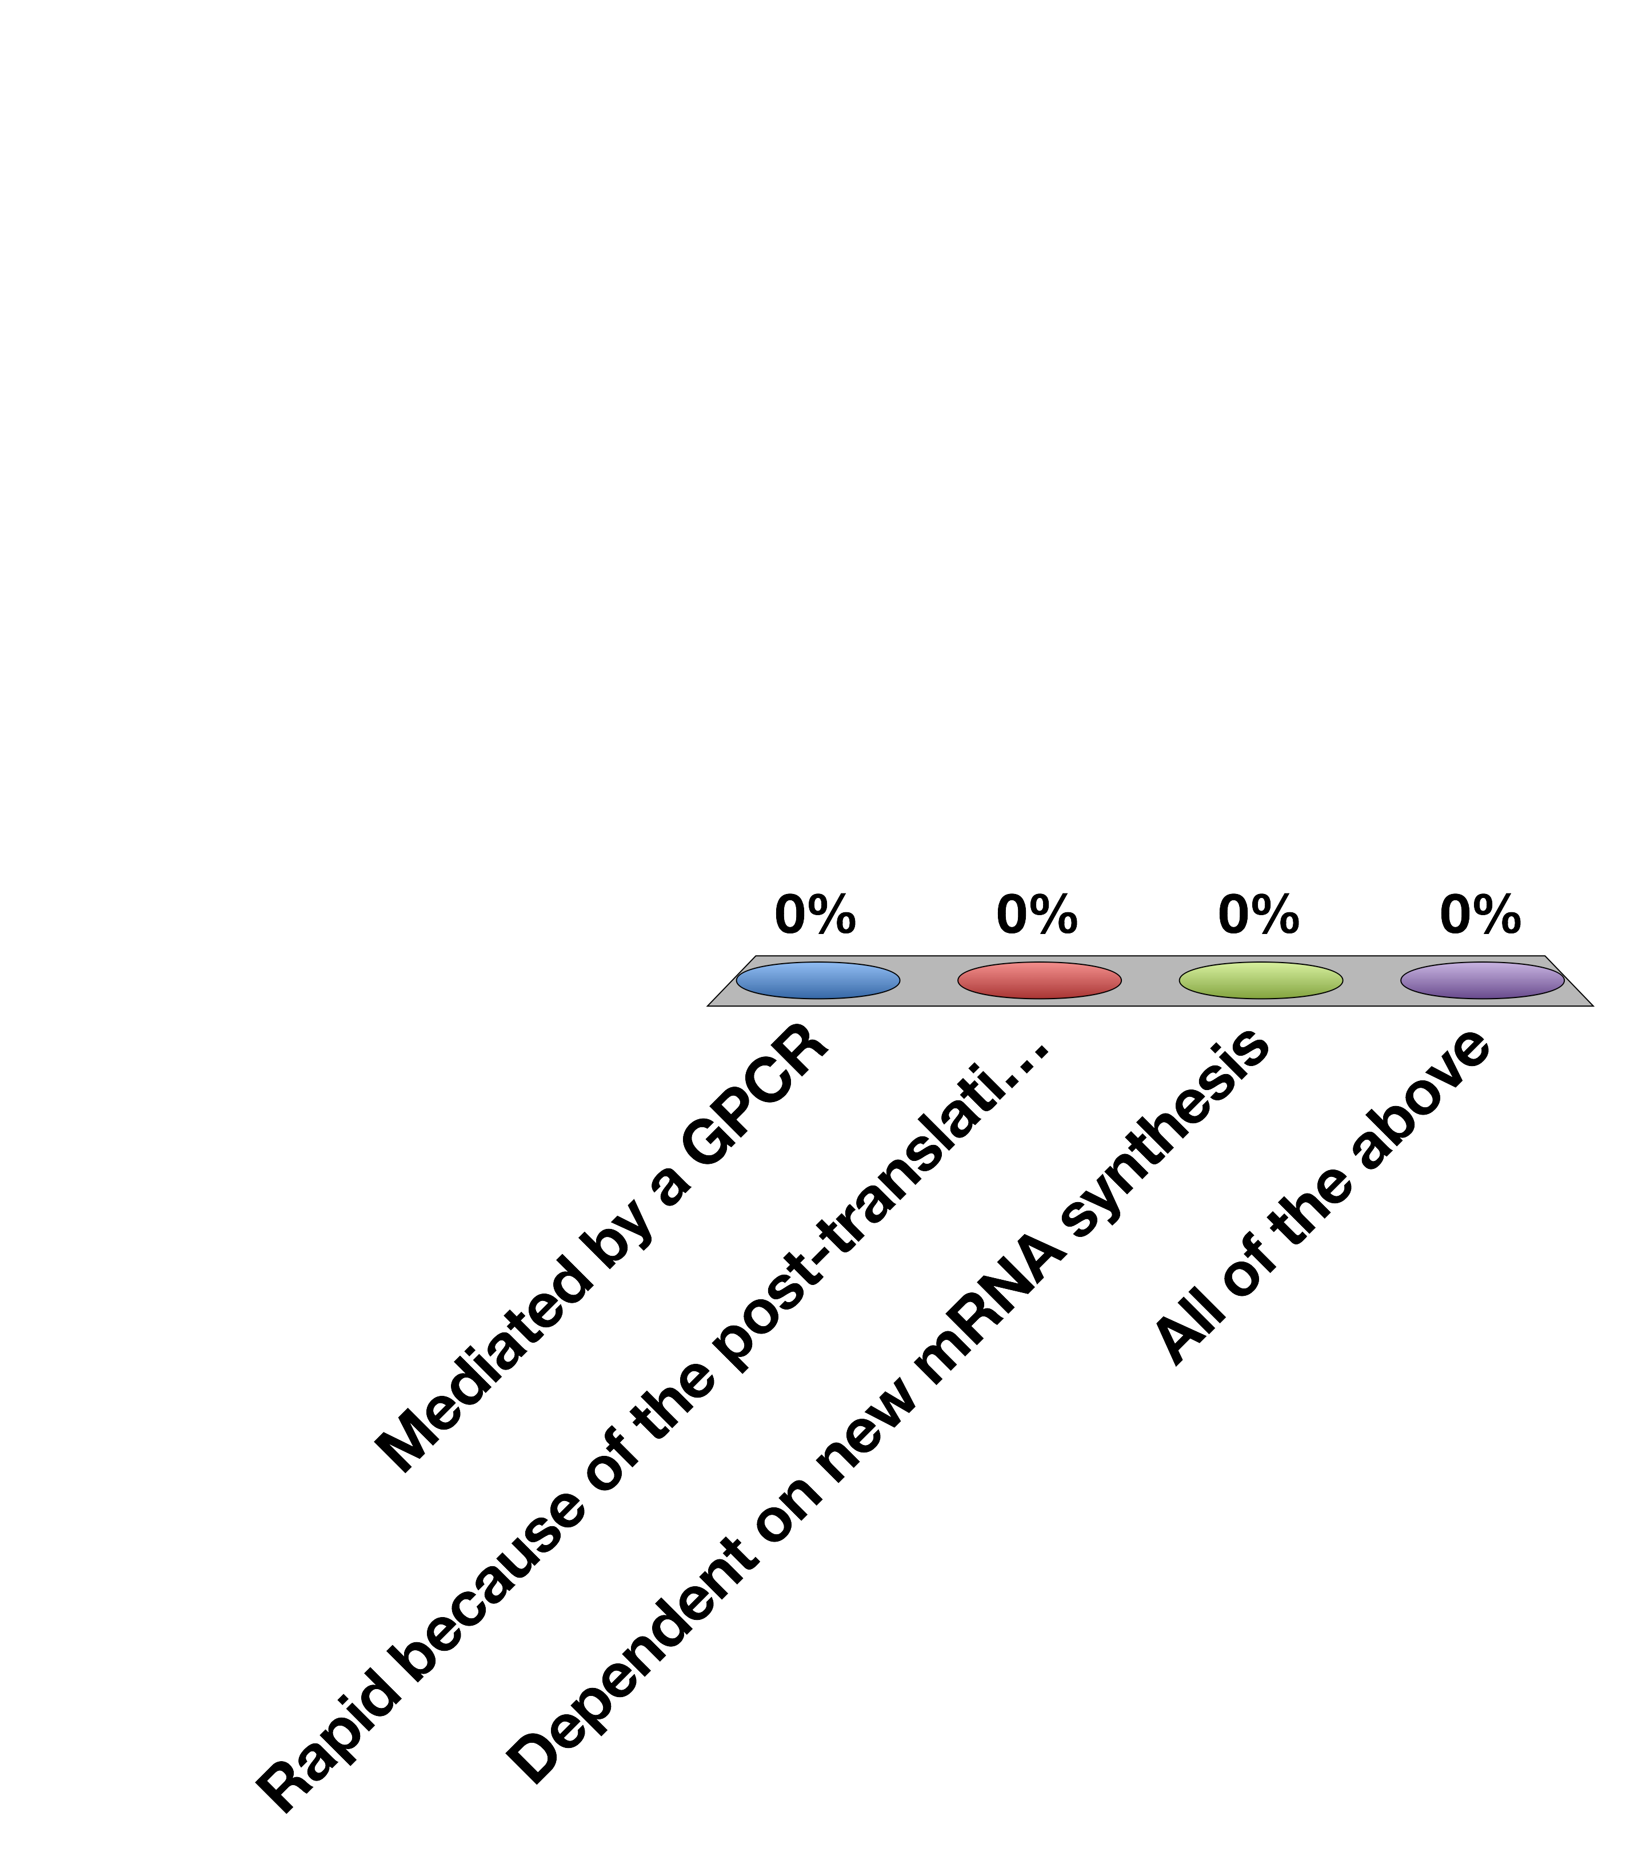
Direct Aldosterone Effects on Cells Are…
Mediated by a GPCR
Rapid because of the post-translational modification of enzymes
Dependent on new mRNA synthesis
All of the above
30

Slide 17
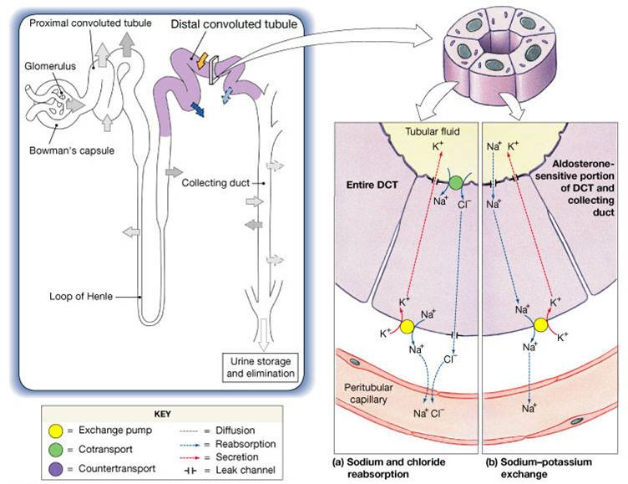
Key Aldosterone Effectors
ENac
Na/K
Notes:
Mention talking about how aldsosterone is regulated
Should be here at 15 minutes

Slide 18
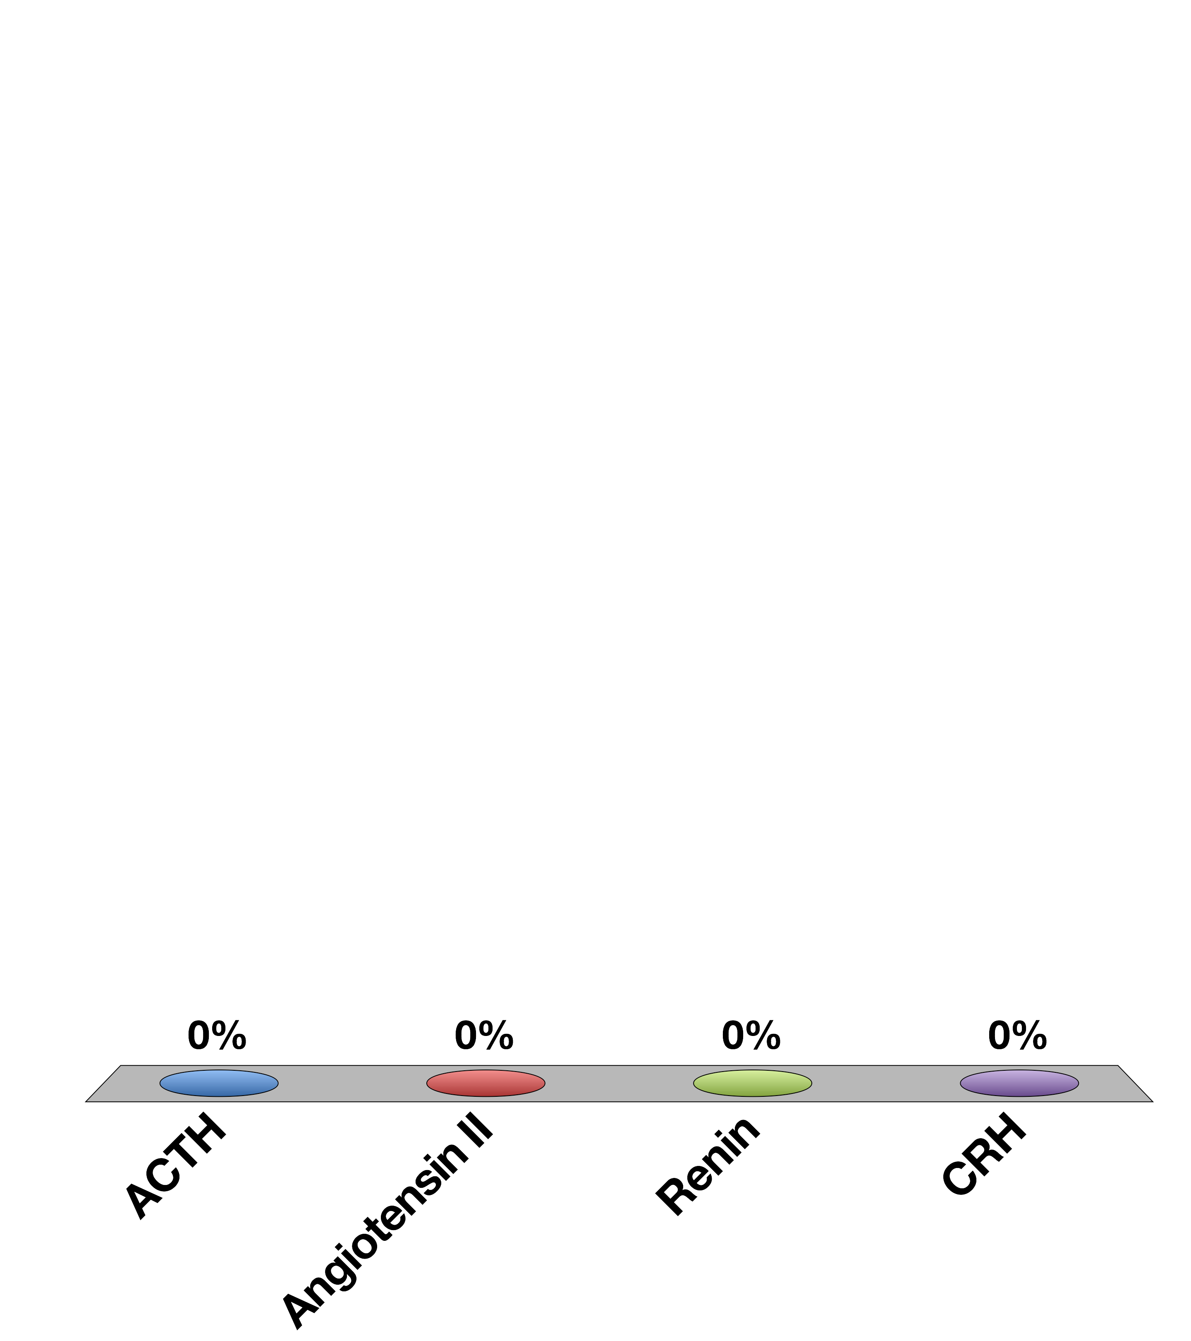
Which hormone stimulates Aldosterone production?
ACTH
Angiotensin II
Renin
CRH
15

Slide 19
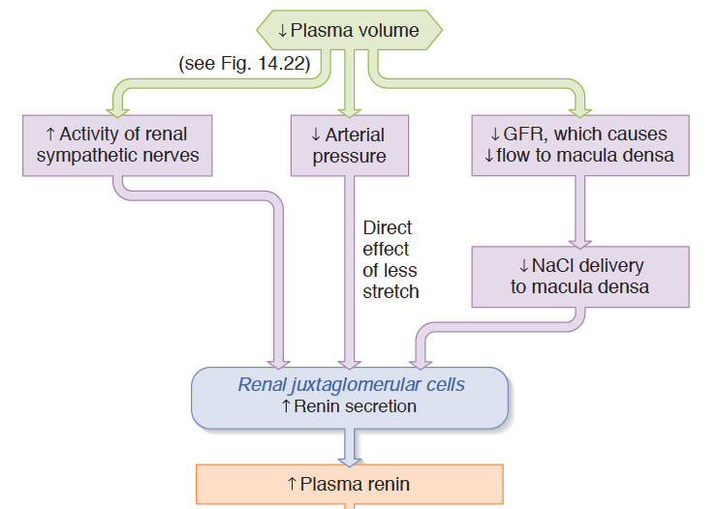
Renin as a Volume/Pressure Sensor
Notes:
Mechanotransduction and sympathetic activity

Slide 20
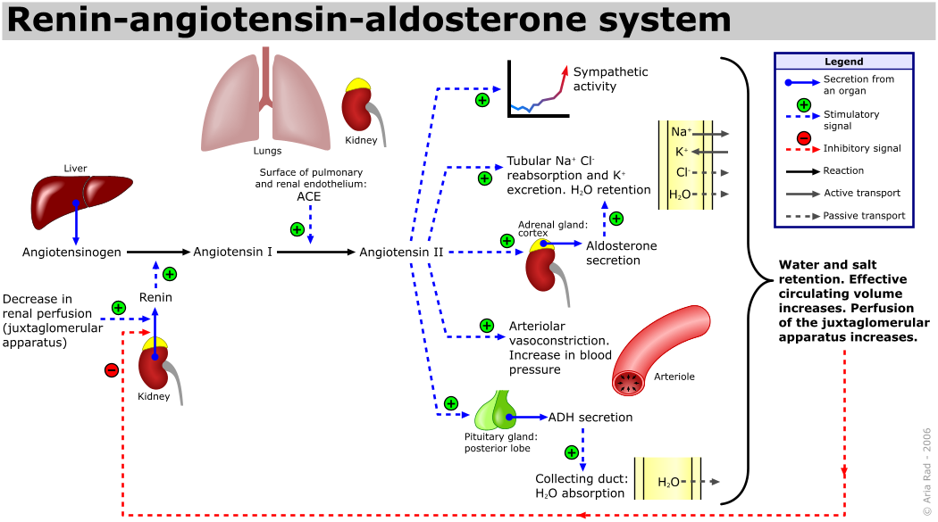
The Renin/Angiotensin System
Notes:
Point out the negative feedback occurs via sensing at the JG cell.
Quick effect via angiotensin, long term effect via aldosterone
Less stretch, less
This is separate to just the effects of vasopressin

Slide 21
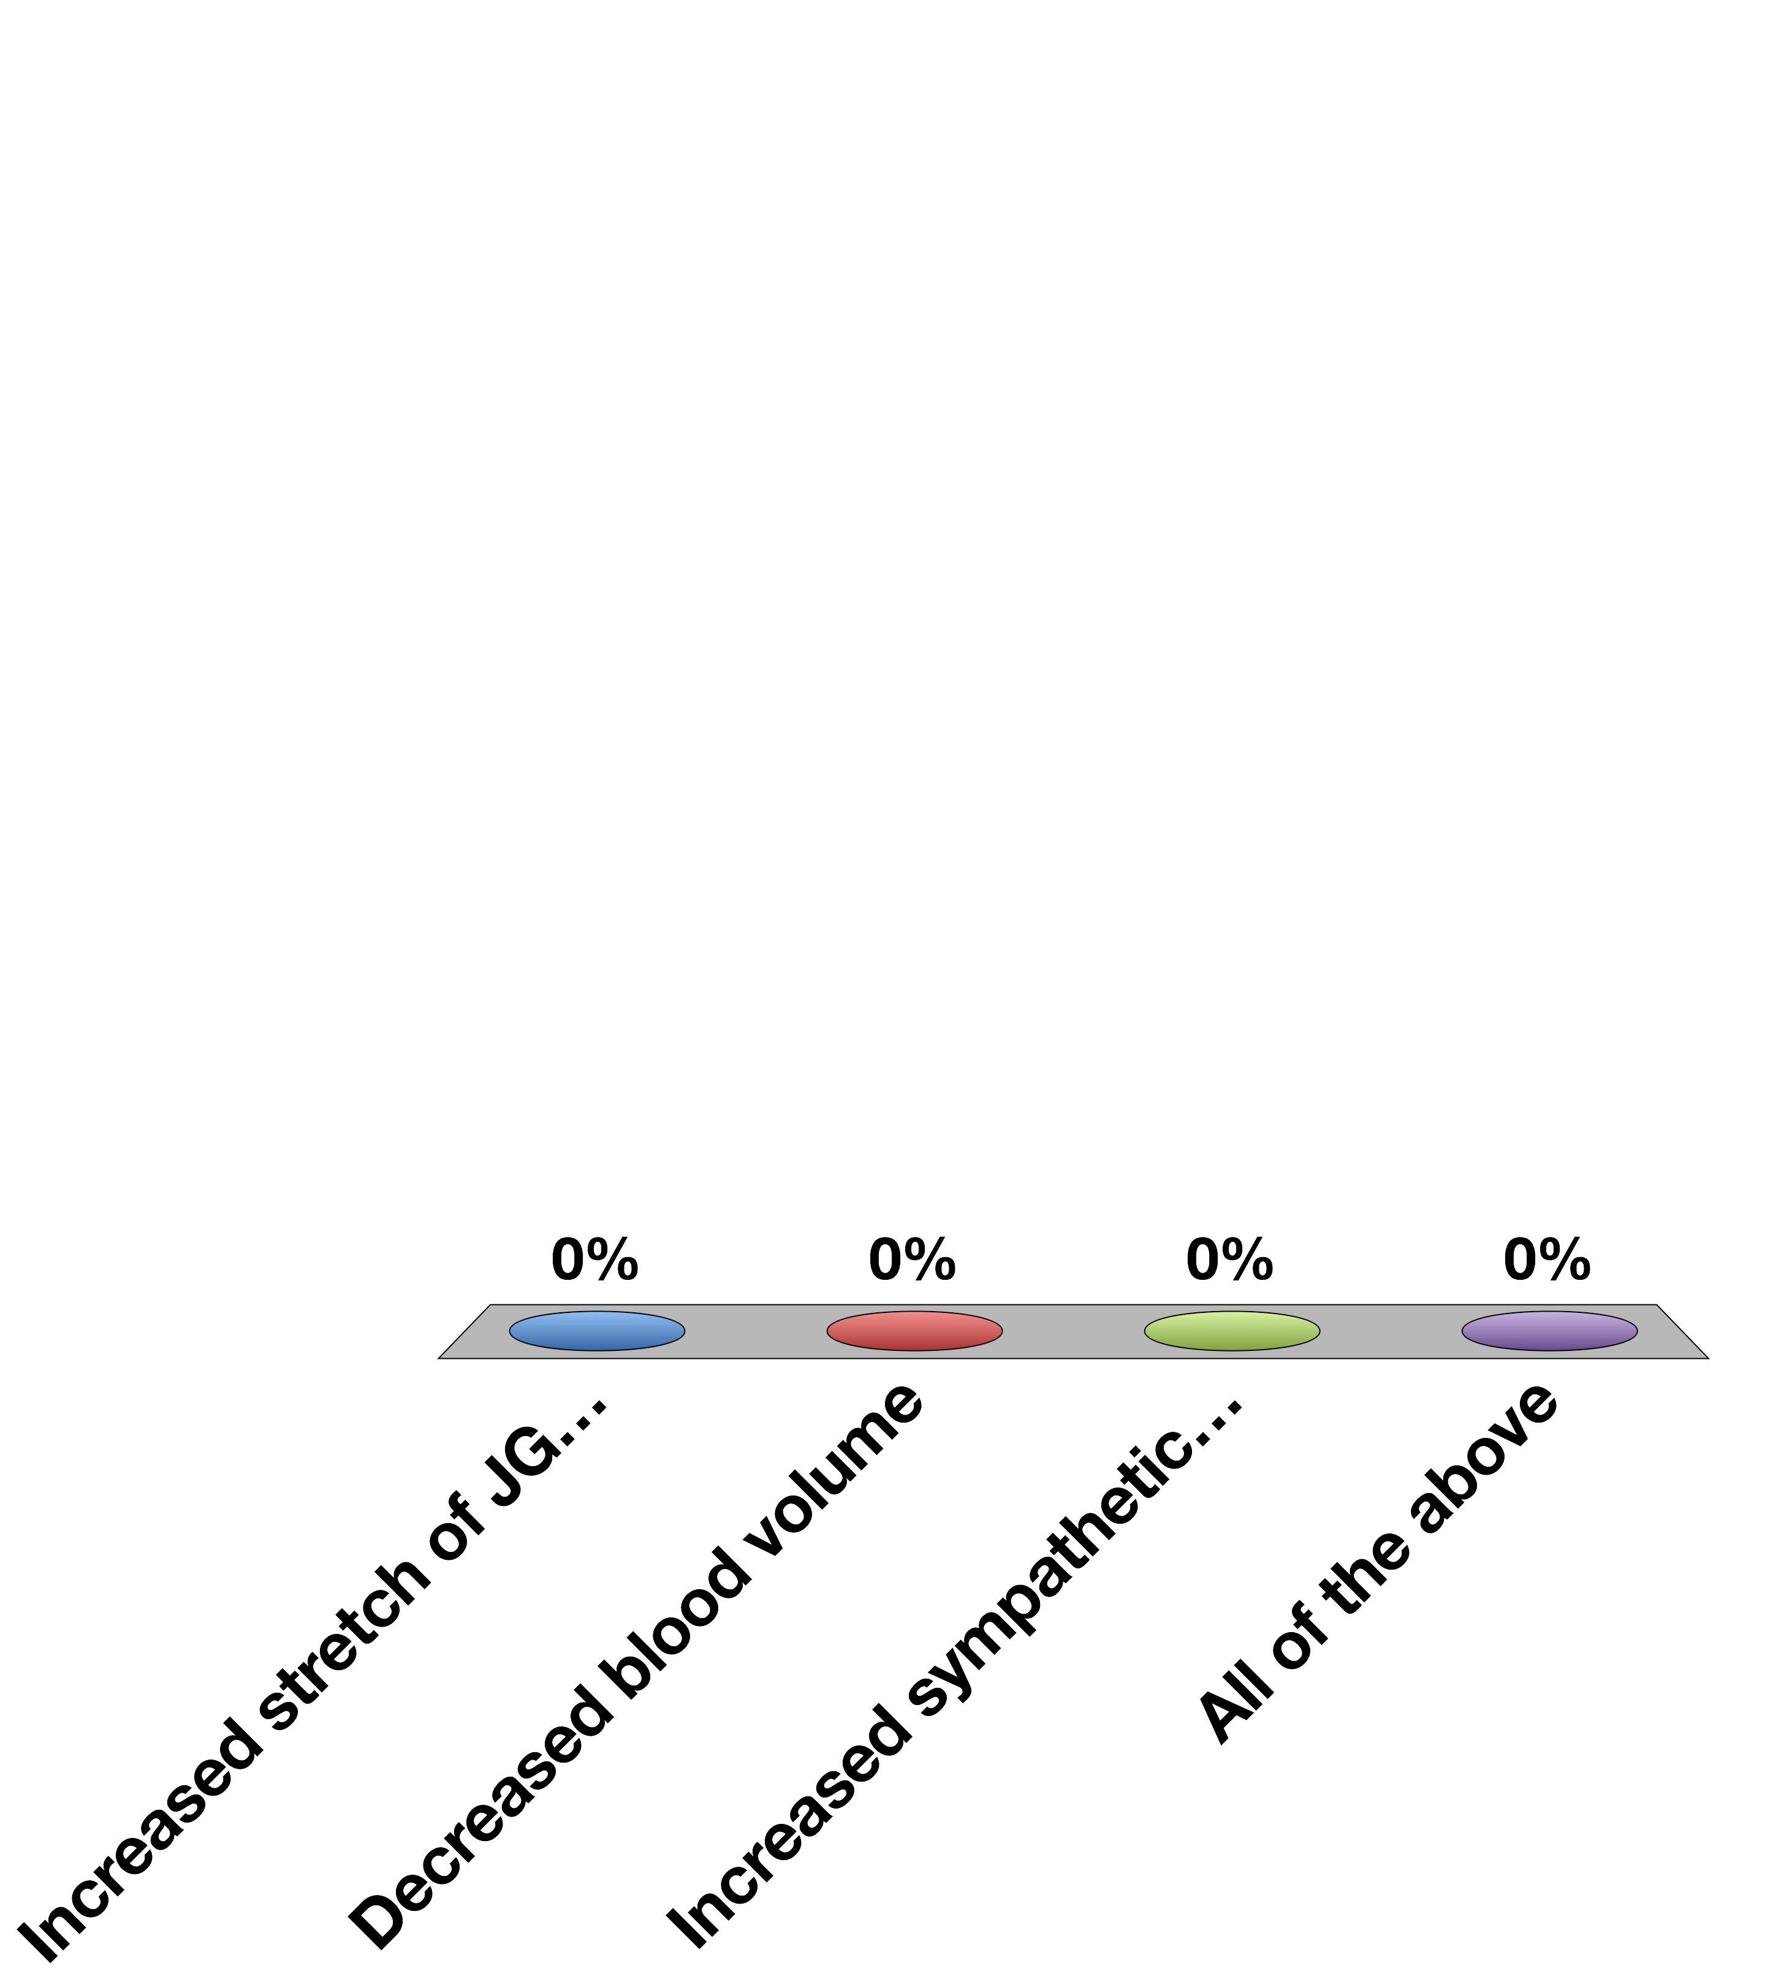
Renin Secretion is Stopped By
Increased stretch of JG cell
Decreased blood volume
Increased sympathetic tone
All of the above
30

Slide 22
Stress Responsive Hormones

Slide 23

Two Types of Stress Response
Adrenaline
Cortisol
Notes:
Short term, need to get away from the snake
Chronically they are better prepared for a snake attack, energy is partitioned in away to be prepared for a snake attack, but long term normal functions such as growth, reproductive function and immunity are still suppressed

Slide 24

Which hormone should mediate chronic stress responses?
Epinephrine because it functions quickly
Epinephrine because its effects last longer
Cortisol because it functions quickly
Cortisol because its effects last longer
30

Slide 25
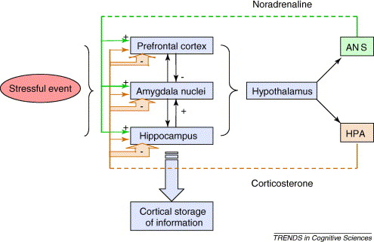
CRH Release

Slide 26
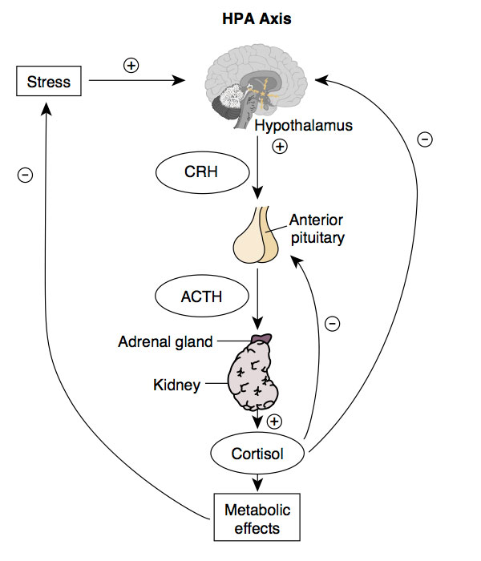
HPA Axis

Slide 27
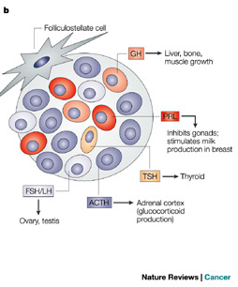
Anterior Pituitary
Hypothalamic | Anterior Pituitary | Cells
CRH | ACTH | Corticotropes
TRH | TSH/Prolactin | Thyrotropes/ Lactotropes
GnRH | LH/FSH | Gonadotropes
GHRH | GH (increase) | Somatotropes
Somatostatin | GH (decrease) | Somatotropes
Asa SL, Ezzat S (2009) The pathogenesis of pituitary tumors. Annu Rev Pathol 4: 97–126. doi:10.1146/annurev.pathol.4.110807.092259.
Notes:
Each cell type is responsible for a particular kind of hormone secretion
Mention all GPCRs

Slide 28
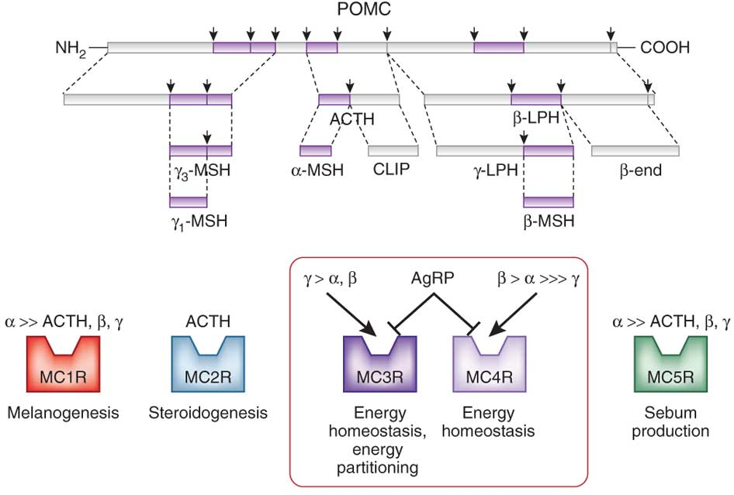
ACTH and other Hormones are Generated from POMC Transcripts

Slide 29
Corticotropin Releasing Hormone
Where is it made? | Hypothalamus (PVN)
What causes its release? | Stress (Synaptic Inputs)
What are its receptors? | CRHR1/2 (Gs)
What tissues does it affect? | Corticotropes in the Anterior Pituitary | ACTH Release
How does it get turned off? | Receptor desensitization, Cortisol Negative Feedback to Hypothalamus

Slide 30
ACTH
Where is it made? | Corticotropes of the Anterior Pituitary
What causes its release? | CRH into the hypophysial portal system
What are its receptors? | ACTHR (Gs - GPCR)
What tissues does it affect? | Adrenal Cortex | Cortisol synthesis
How does it get turned off? | Receptor desensitization, Cortisol Negative Feedback to Hypothalamus, Cortisol Negative Feedback to Hypothalamus

Slide 31
Cortisol Summary
Where is it made? | Adrenal Cortex (Zona fasciculata)
What causes its release? | ACTH (GPCR –Gs)
What are its receptors? | Glucocorticoid Receptor
What tissues does it affect? | Muscle | Protein Catabolism
 | Adipose | Increased Lipolysis, Adipogenesis
 | Liver | Increased Gluconeogenesis
 | Brain | Less Food Intake
 | Immune System | Reduced Th2 Activation
How does it get turned off? | Receptor desensitization, Negative Feedback to Pituitary, Negative Feedback to Hypothalamus, 11BHSD2

Slide 32
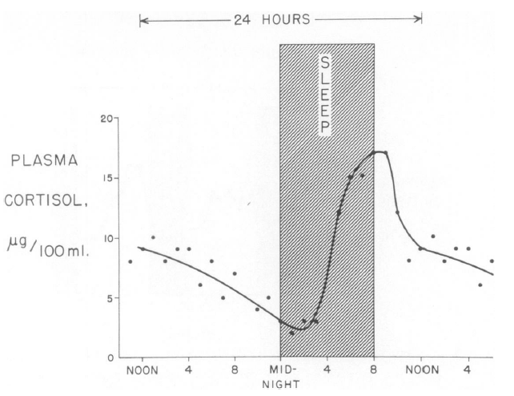
Daily Rhythms of Cortisol Release
Liddle GW (1966) An analysis of circadian rhythms in human adrenocortical secretory activity. Trans Am Clin Clim Assoc 77: 151–160.
Notes:
Related to this, prolonged fasts also elevate cortisol levels

Slide 33
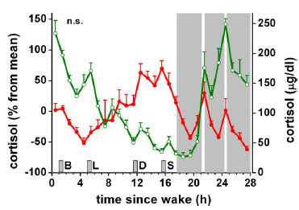
Night Time Workers
Normal
Sleep disrupted
Scheer F AJL, Hilton MF, Mantzoros CS, Shea S A (2009) Adverse metabolic and cardiovascular consequences of circadian misalignment. Proc Natl Acad Sci U S A 106: 4453–4458. doi:10.1073/pnas.0808180106.
Notes:
Fedex workers

Slide 34
Major Chronic Responses to Stress
Shift resources (mainly glucose) towards essential functions
Suppress non-essential functions
Immune system
Reproductive system
Growth
Notes:
Should be here at 25 minutes

Slide 35
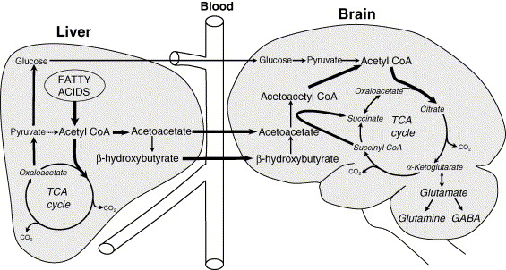
Brain Requires Glucose Supply
Notes:
Dosent store glycogen, limited gluconeogenic capacity
Glucose is produced by a process called gluconeogenesis

Slide 36
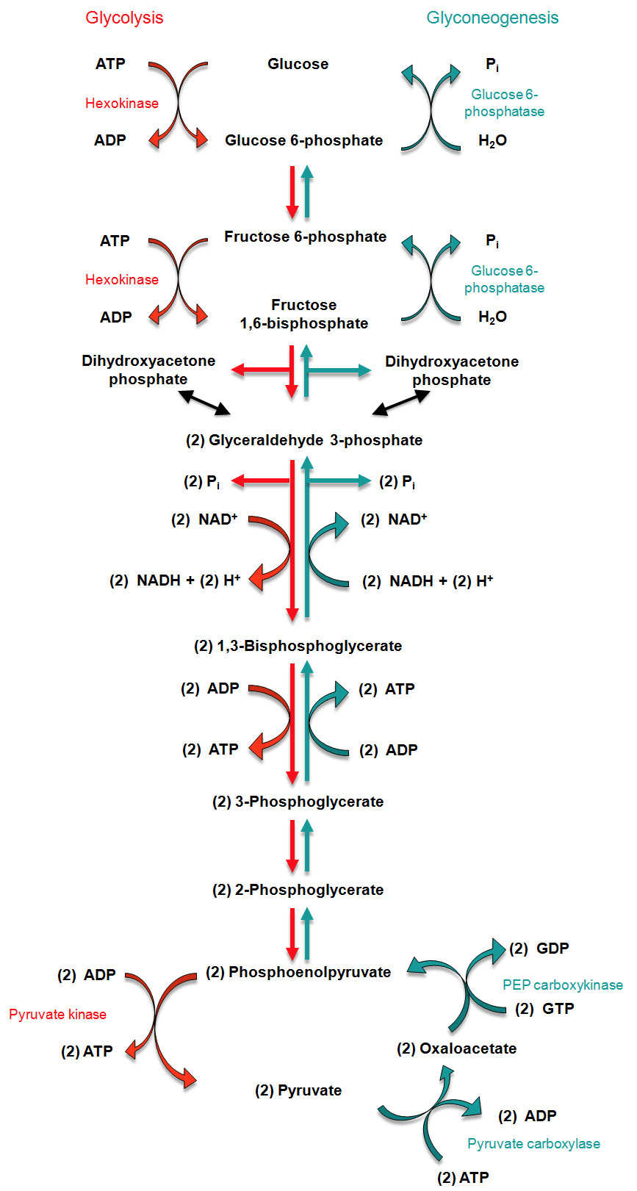
Regulation of Gluconeogenesis
Activation of mRNA transcription
by glucocorticoids in the liver
Notes:
Don’t need to know this, but the flow is going this way. The rate limiting steps are in blue

Slide 37
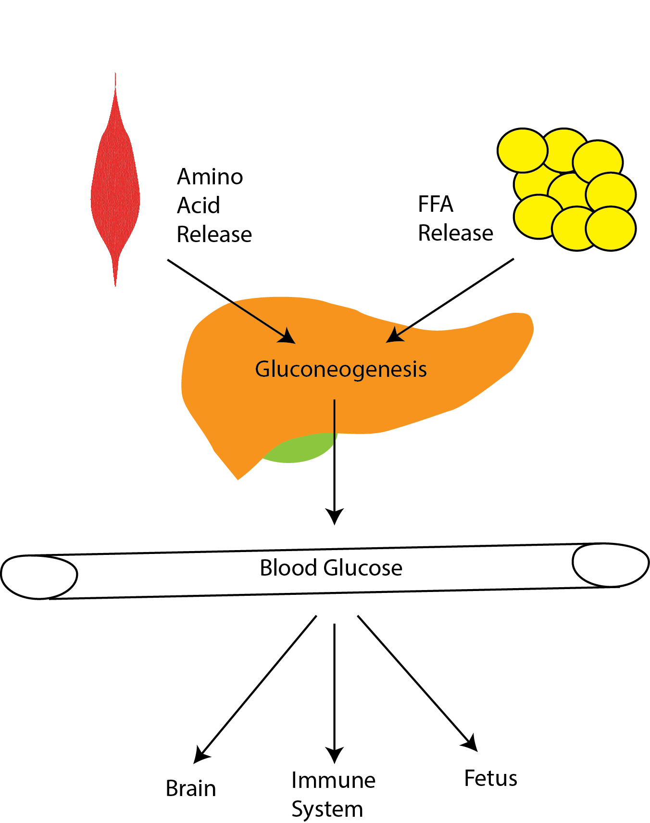
Cortisol Maintains Blood Glucose Levels
Notes:
Induces gluconeogenesis
Induces protein/triglyceride breakdown
Promotes insulin resistance

Slide 38
Three Mechanisms to Maintain Blood Glucose Levels
Promote gluconeogenesis (liver)
Provide substrates for gluconeogenesis (muscle/fat)
Prevent glucose uptake (muscle/fat)

Slide 39
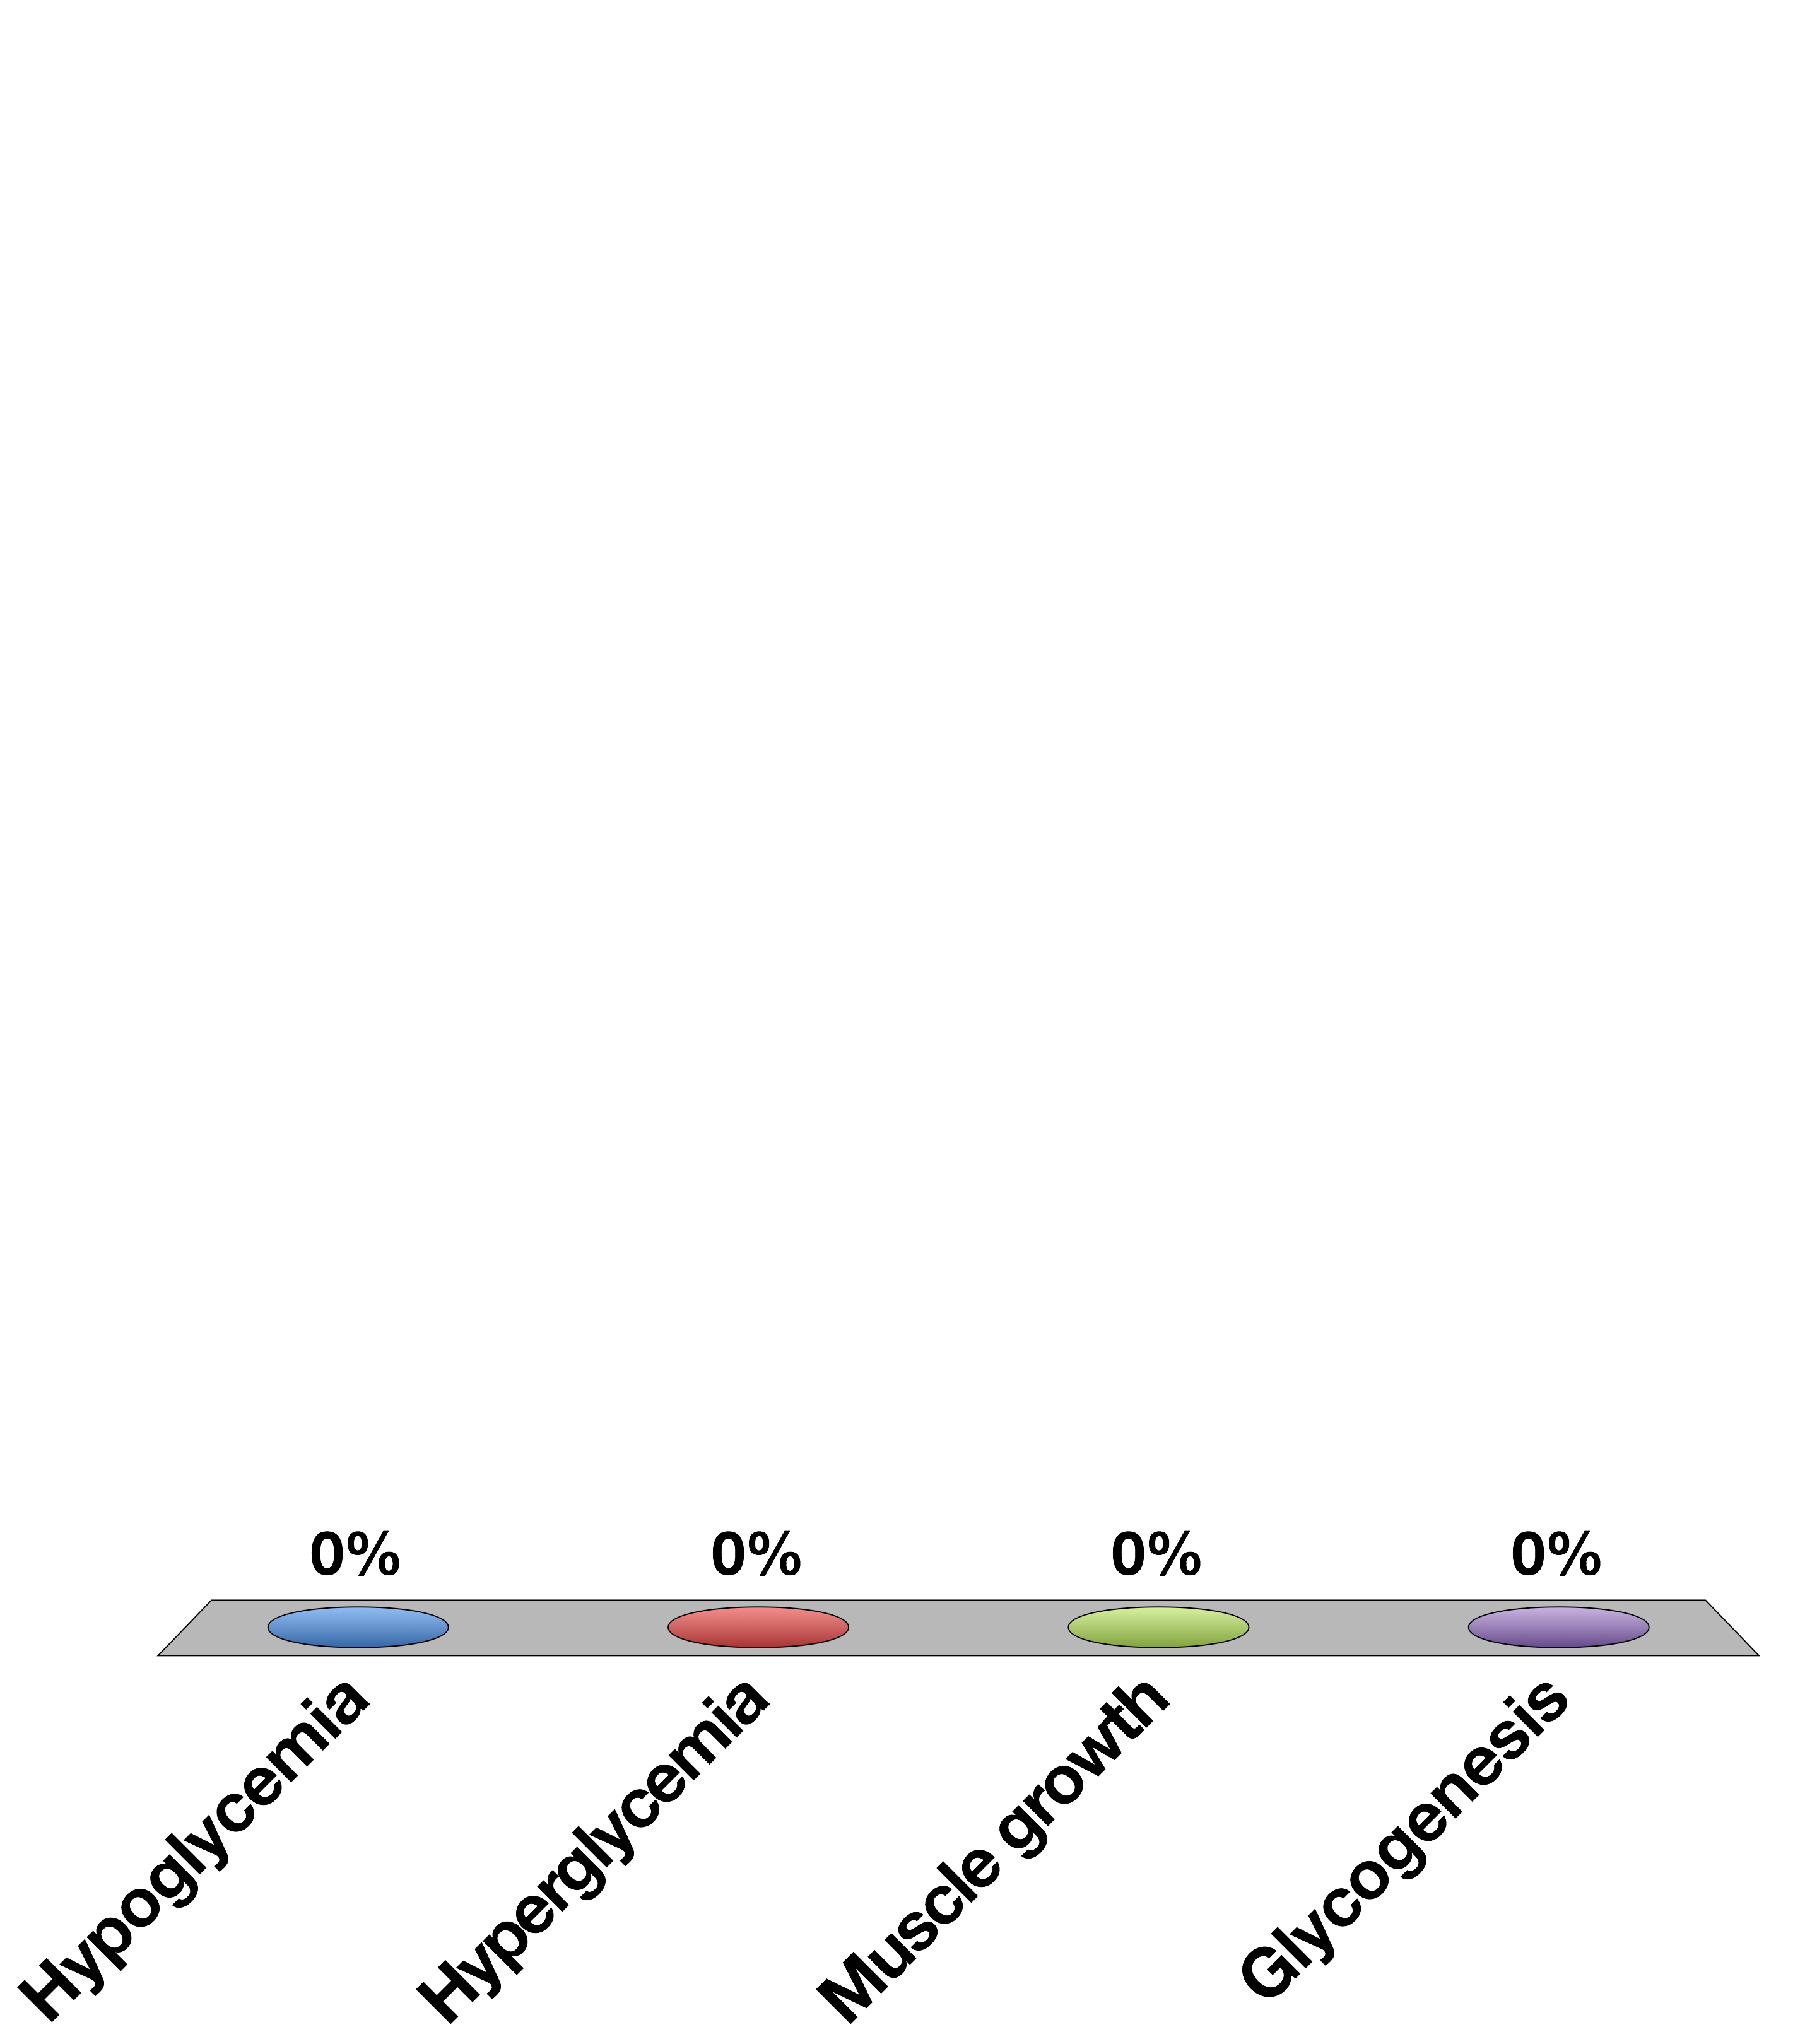
Chronically elevated glucocorticoid signaling would cause
Hypoglycemia
Hyperglycemia
Muscle growth
Glycogenesis
30

Slide 40
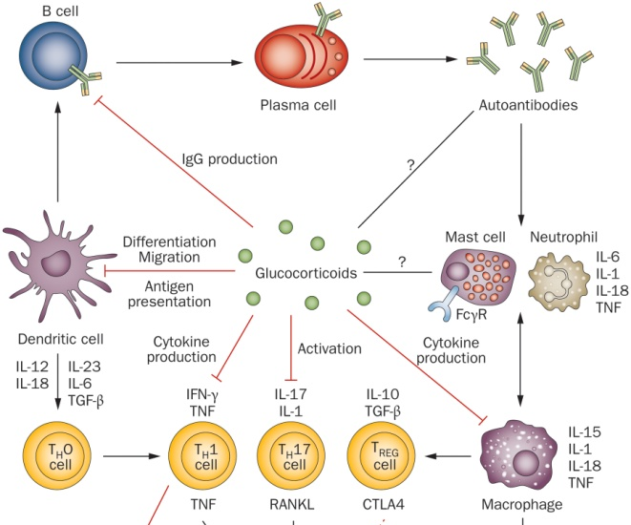
Effects of Cortisol on Immune Function
Notes:
Differentiation of precursors into differentiated immune cells, in both the innate and adaptive immune system

Slide 41
Negative Regulation of Glucocorticoid Function

Slide 42
HPA Axis
Notes:
Negative feedback of glucocorticoid function

Slide 43
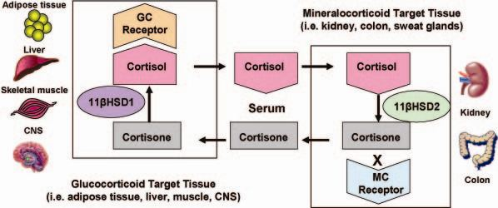
11β-HSD 2 and Local Concentrations of Glucocorticoids
In off target tissues,
or to desensitize normal tissues
Notes:
Problem is that cant restrict steroid hormones from getting into the cells, in the way that you can not express insulin receptors to prevent insulin action
This system accomplishes two things:
Since there is some weak effects of cortisol on the MC receptor this is a way to ensure no abberant MC signaling in the wrong tissues
Secondly this is a way for a tissue to locally control levels are part of a negative feedback mechanism

Slide 44
Learning Objectives
Name the cell types of the Islets of Langerhans and name the hormones secreted by them.
Describe the main targets and functions of glucagon.
List the major factors that stimulate or inhibit glucagon and insulin.
Describe the important physiological roles of insulin.
List the major actions of insulin in muscle, adipose tissue, and liver.
Explain briefly the mechanism of glucose uptake into the muscle.
Name the tissues in which insulin facilitates glucose uptake and those in which insulin does not facilitate glucose uptake.
List the major factors that stimulate or inhibit insulin secretion.
Draw an oral glucose tolerance test (oGTT) (glucose, insulin, and glucagon levels) and and describe what is occurring and why. Explain how the two hormones act to promote glucose homeostasis in the plasma.
State which nutrient storages are preferably used for short-term regulation of energy metabolism if no nutrients are available from the GI tract.
Discuss the hormones involved, fuel storage capacity, fuel storage consumption, and glucose (or fatty acid) levels during 1) the postprandial period, 2) the post-absorptive period, 3) fasting.
List the insulin-counteracting hormones and their roles in glucose homeostasis. Discuss the hormones involved in minute-to-minute regulation and long-term regulation of glucose homeostasis.

Slide 45
About last Wednesday…
Glucagon secretion diabetics
Impaired glucagon suppression by hyperglycemia
hyperglucagonemia consider the mechanism of this
Error in handout, “Anatomy of adrenal gland section”
The three regions of the adrenal medulla cortex release steroid hormones including aldosterone, cortisol, and androstenedione.
Quiz question
Renin secretion is stopped by decreased sympathetic tone

Slide 46
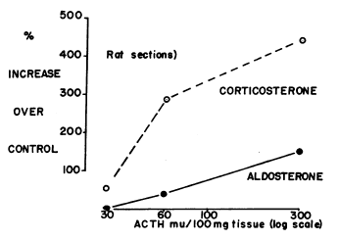
ACTH can promote Aldosterone - but physiologically there is no reason to believe that it has a direct action
N. M. Kaplan, F. C. Bartter, THE EFFECT OF ACTH, RENIN, ANGIOTENSIN II, AND VARIOUS PRECURSORS ON BIOSYNTHESIS OF ALDOSTERONE BY ADRENAL SLICES, J. Clin. Invest. 41, 715–724 (1962).

Slide 47
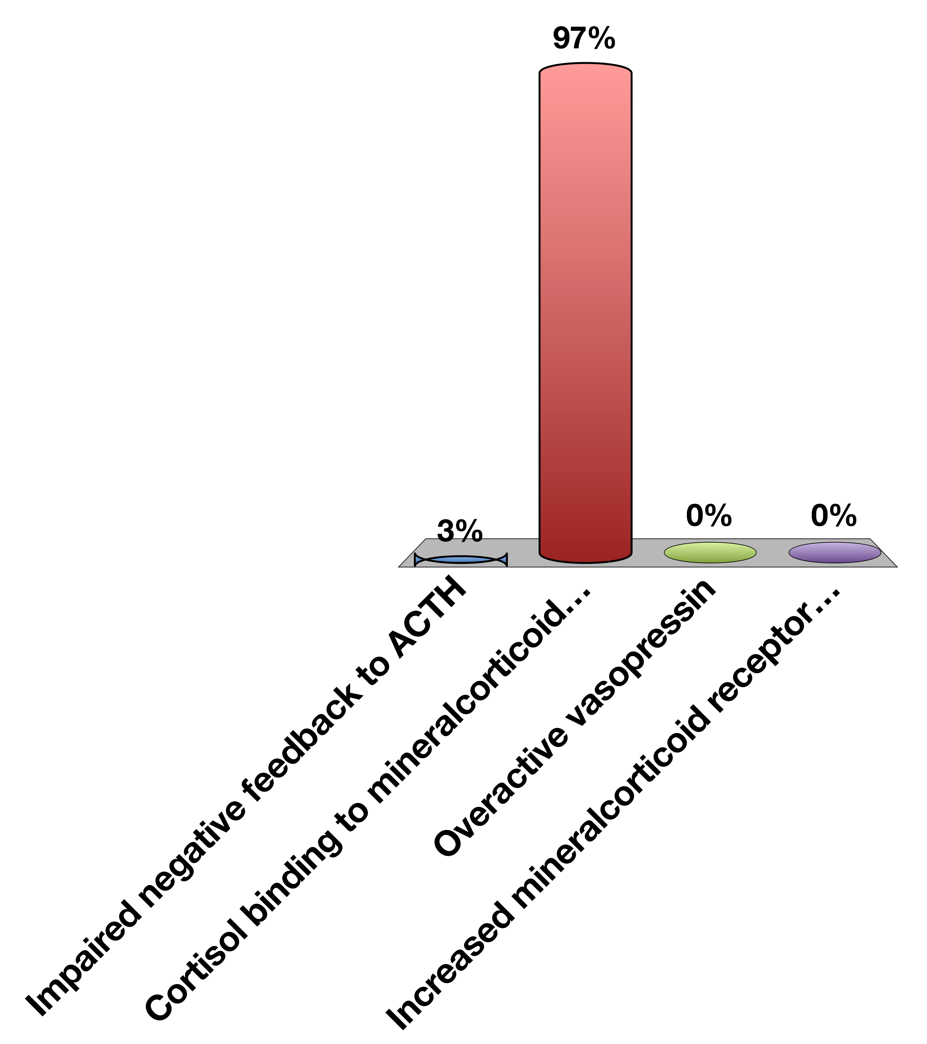
A subject with an ACTH secreting tumor has hypertension, but not increased aldosterone, why?
Impaired negative feedback to ACTH
Cortisol binding to mineralcorticoid receptor
Overactive vasopressin
Increased mineralcorticoid receptor sensitivity
0

Slide 48
Adrenaline Mediates Short-Term Stress Responses
Notes:
Should be here at 40 mins

Slide 49
Epinephrine Summary
Where is it made? | Adrenal medulla
What causes its release? | Sympathetic nervous stimulation
What is its receptor? | Alpha/Beta-Adrenergic Receptors (5 subtypes) | GPCR -> Gs, Gq and Gi
What tissues does it affect? | Heart | Increased heart rate
 | Lungs | Increased respiration
 | Vasculature | Vasoconstriction or vasodilation
 | Liver | Glycogenolysis and gluconeogenesis
 | Fat | Lipolysis
 | Skeletal Muscle | Contraction, Glycolysis, Oxidative Phosphorylation
How does it get turned off? | Sympathetic signal stops, Receptor desensitization

Slide 50
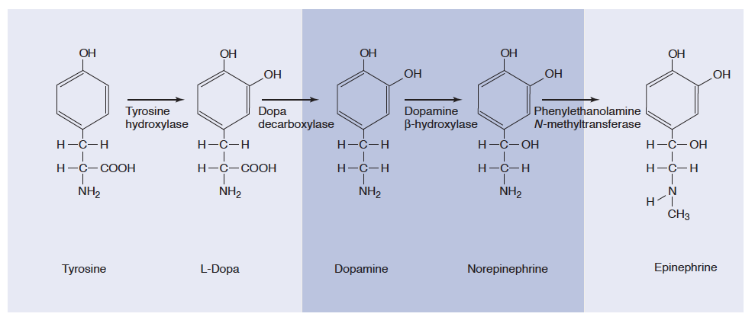
Epinephrine and Norepinephrine
Notes:
Adrenal medulla has high levels of PNMT

Slide 51
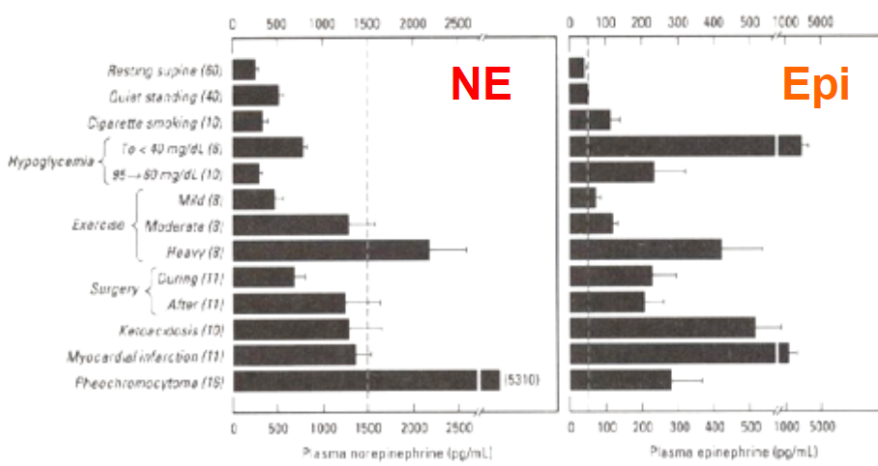
Epinephrine vs Norepinephrine
Dashed line is level in circulation needed to elicit a physiological response

Slide 52
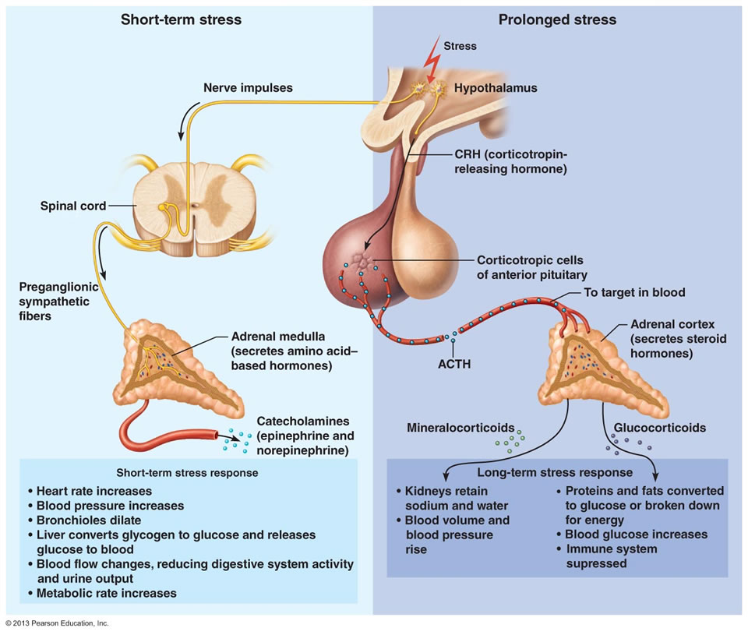
Adrenaline vs Cortisol Release

Slide 53
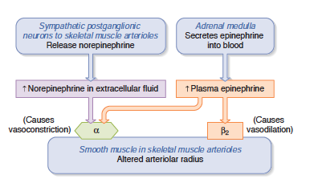
Cardiovascular Roles of Epinephrine
Three effects on vasculature:
Contraction of cardiac muscle (beta1/Gs)
Relaxation of muscle, bronchiolar and GI tract smooth muscle (beta2/Gi)
Contraction of vascular smooth muscle in kidney, GI and brain (alpha/Gq)
Notes:
Gi/Gq vasoconstriction
Gs vasodilation and heart muscle contraciton

Slide 54
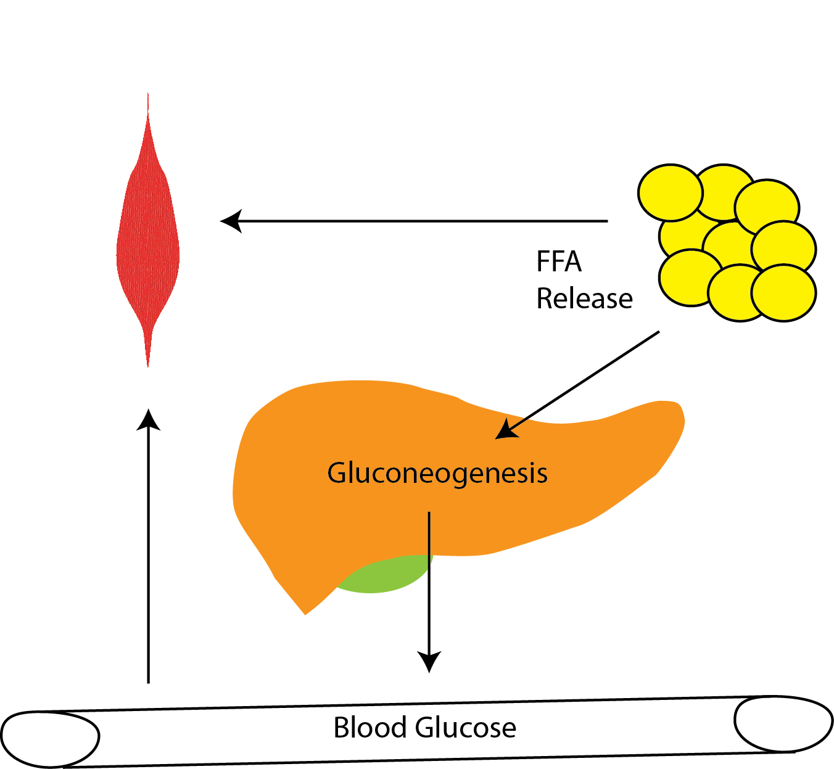
Metabolic Roles of Epinephrine
Cortisol
Epinephrine
Notes:
Discuss similarities and differences between cortisol and epinephrine.
Spend some time, talking about why these differences exist

Slide 55
Talk Amongst Yourselves
What tissue should respond the same to both glucagon and adrenaline signaling? What is a tissue what would respond differently?
What would happen if these tissues both responded in the same way?

Slide 56
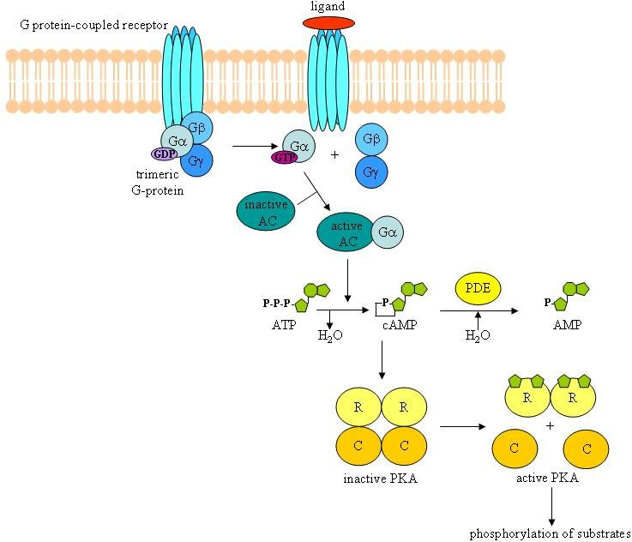
Epinephrine Binds B-AR/Gs in Skeletal Muscle, Liver and Fat Tissue

Slide 57
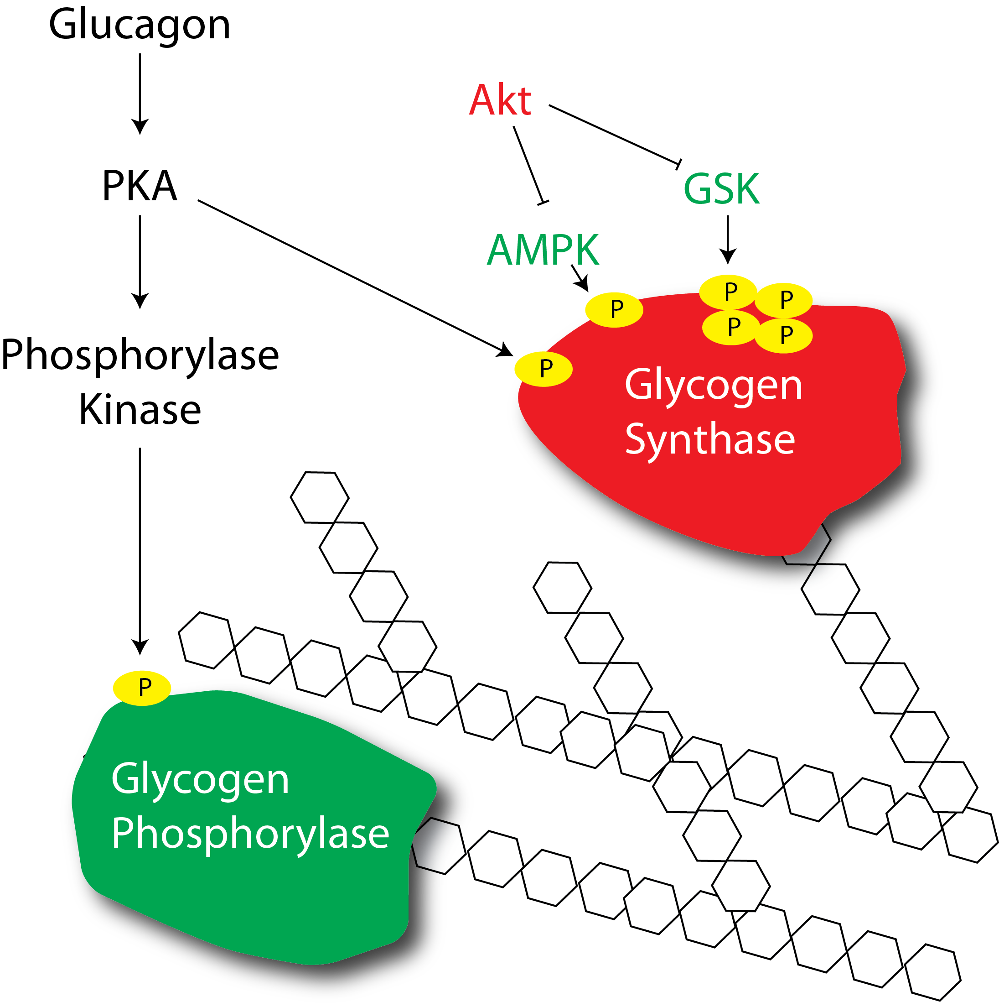
Epinephrine Mediated Activation of Glycogenolysis

Slide 58
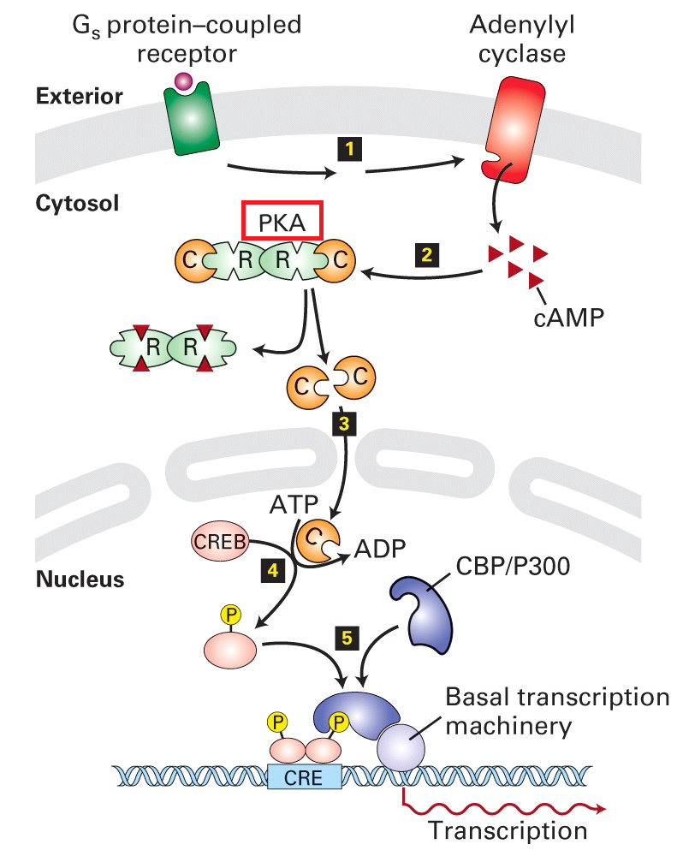
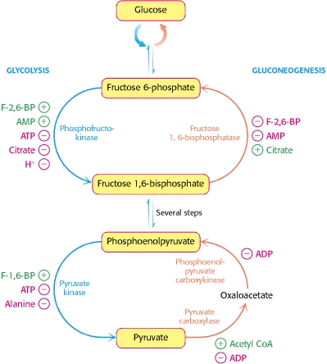
Dual Effects of Epinephrine on Gluconeogenesis in the Liver
PKA
PFK-2
Post-Translational Induction of Gluconeogenesis
Gluconeogenic Gene Transcription

Slide 59
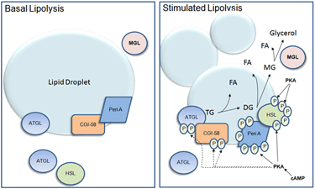
Effects of Epinephrine on Lipid Breakdown

Slide 60

β-AR agonists would be good weight loss drugs except…
They would induce lipid breakdown
They would cause tachycardia
They would cause GI vasodilation
They would prevent gluconeogenesis in the liver
0

Slide 61
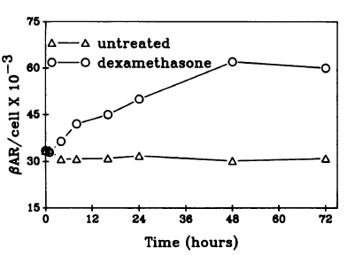
Short Term and Long Term Stress
Chronic Stress
Acute Stress
Cortisol
Epinephrine
Elevated Transcription of
Beta-Adrenergic
Receptors
Glucocorticoid
Receptor
Higher sensitivity
towards epinephrine
Hadcock JR, Malbon CC (1988) Regulation of beta-adrenergic receptors by “permissive” hormones: glucocorticoids increase steady-state levels of receptor mRNA. Proc Natl Acad Sci U S A 85: 8415–8419. doi:10.1073/pnas.85.22.8415.

Slide 62
Learning Objectives
Name the cell types of the Islets of Langerhans and name the hormones secreted by them.
Describe the main targets and functions of glucagon.
List the major factors that stimulate or inhibit glucagon and insulin.
Describe the important physiological roles of insulin.
List the major actions of insulin in muscle, adipose tissue, and liver.
Explain briefly the mechanism of glucose uptake into the muscle.
Name the tissues in which insulin facilitates glucose uptake and those in which insulin does not facilitate glucose uptake.
List the major factors that stimulate or inhibit insulin secretion.
Draw an oral glucose tolerance test (oGTT) (glucose, insulin, and glucagon levels) and and describe what is occurring and why. Explain how the two hormones act to promote glucose homeostasis in the plasma.
State which nutrient storages are preferably used for short-term regulation of energy metabolism if no nutrients are available from the GI tract.
Discuss the hormones involved, fuel storage capacity, fuel storage consumption, and glucose (or fatty acid) levels during 1) the postprandial period, 2) the post-absorptive period, 3) fasting.
List the insulin-counteracting hormones and their roles in glucose homeostasis. Discuss the hormones involved in minute-to-minute regulation and long-term regulation of glucose homeostasis.

